Slide 1
CHAPTER 23 ROOTS, STEMS AND LEAVES
FUNCTION OF ROOTS
FUNCTION OF STEMS
FUNCTION OF LEAVES

Slide 2
PLANT TISSUE SYSTEMS
DERMAL TISSUE
VASCULAR TISSUE
GROWTH TISSUE

Slide 4
DERMAL TISSUE
-outer covering of a plant consists of dermal tissue which consists of layers of epidermal cells.
-dermal tissue is often covered a thick waxy
layer that protects against water loss and injury
- this waxy covering is called the cuticle.
-some epidermal cells have tiny projections called trichomes which help protect the leaf and also give it a fuzzy appearance.

Slide 6
Dermal Tissue continued
In roots dermal tissue includes root hair cells that provide a large amount of surface area and aid in water absorption.
On the underside of leaves, dermal tissue, contains guard cells, which regulate water loss and gas exchange.

Slide 7
VASCULAR TISSUE
Forms a transport system that moves water and nutrients throughout the plant.
Main subsystems – xylem and phloem.
Contains specialized cells called tracheids and vessel elements (xylem); sieve tube elements and companion cells (phloem).
Both xylem and phloem are made up of networks of hollow connected cells that carry fluids throughout the plant

Slide 10
i. Xylem
Transports water away from the roots and throughout the plant.

Slide 11
ii. Phloem
Phloem
Provides a conduit thru which sugars and other foods are carried in water.

Slide 12
GROUND TISSUE
Cells that lie btw dermal tissue and vascular tissue make up the ground tissue – parenchyma cells -have thin cell walls and large central vacuoles surr by a thin layer of cytoplasm.
In leaves parenchyma cells are stacked with chloroplasts – site of photosynthesis.
Ground tissue may also contain two other types of cells which have a thicker cell wall:
-collenchyma cells -sclerenchyma cells

Slide 13
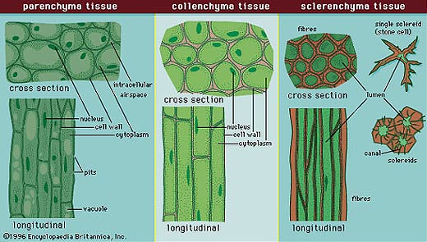
-collenchyma cells -support cells – make up the strings of a stalk of celery.
-sclerenchyma cells – make ground tissue tough and strong.

Slide 14
Plant Growth and Meristematic Tissue pp582 - 583
-A plant grows longer and thicker in girth over its lifetime.
I. PRIMARY GROWTH
- grows in length due to cell production at the tips of roots, tips of shoots - area called the apical meristem.
-meristematic tissue is the only plant tissue that produces new cells by mitosis.

Slide 15
-flowers develop at the apical meristem of a shoot.

Slide 16
Secondary Growth
-increase in thickness/girth of the plant.
-takes place at the vascular cambium – meristematic cells produce new xylem and phloem.
-the cambium continues to produce new layers of vascular tissue causing the stem to become thicker and thicker

Slide 17
FORMATION OF WOOD
-as the stems grow thicker, the older xylem near the centre of the stem no longer conducts water and forms heartwood – darkens with age.
-heartwood is surrounded by sapwood which is active in fluid transport and therefore lighter in color.

Slide 18
FORMATION OF BARK
-as the tree thickens the old phloem is pushed outwards.
-as the tree continues to thicken from the inside the phloem tissue on the outside fragments and forms the bark of the tree.
(Bark is old phloem tissue)
(Wood: old xylem is heartwood, new xylem is sapwood.)

Slide 19
23-2 ROOOTS
two main types of roots – taproots – found mainly in dicots and fibrous roots which are found in monocots.
1. Taproot – the primary root grows long and thick while the secondary roots remain small.
Ex. Carrots, dandelions, beets and radishes - have thick taproots that store sugars and starches.

Slide 20
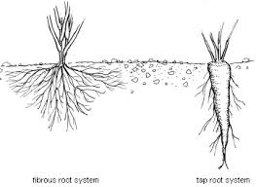
Fibrous roots – branch to such an extent that no single root grows larger than the rest – helps prevent topsoil from being washed away by heavy rain.
Ex. grasses

Slide 21
ROOT FUNCTIONS pp586-588
Anchors a plant in the ground and absorb water and dissolved nutrients from the soil.
Refer to Fig 23-8 on page 586
Essential Plant Nutrients – Nitrogen, Phosphorus, Potassium, Magnessium, Calcium

Slide 22
23-3 STEMS pp589-594
Stem Structure and Function:
-contains 3 tissues – g.t., v.t., d.t.
3 Important functions
i. Produce leaves, branches and flowers
ii. Hold leaves up to the sunlight.
iii. Transport substances btw roots and
leaves.

Slide 23
STEMS continued
Nodes are where leaves are attached.
Internodes are regions btw the nodes
Buds develop where leaves attach to the stem and contain underdeveloped tissue that can produce new stems and leaves.
Woody tissue is developed by stems.

Slide 24
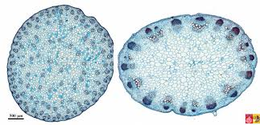
Stems continued
Monocot stems – vascular bundles are scattered thruout the stem
Dicot stems and most gymnosperms vascular bundles are arranged in a cylinder.

Slide 25
GROWTH OF STEMS pp590-591
Primary growth – apical meristem – increases length of plant
Secondary growth – lateral meristematic tissue – increases thickness of plant

Slide 26
STEMS ADAPTED FOR STORAGE AND DORMANCY p594
Tubers, rhizomes, bulbs, corms can remain dormant during cold or dry periods until favorable conditions for growth return.
Potato – tuber , ginger – rhizome, crocus bulb – corm, tulip bulb – bulb.

Slide 27
23-4 LEAVES
Leaf function: photosynthesis
Leaf structure:
Cutile, epidermis
-mesophyll – ground tissue – site of photosynthesis.
- palisade mesophyll
- spongy mesophyll
-stomata formed by guard cells.
-vein – xylem/phloem

Slide 28
NUTRIENT TRANSPORT PP601-602
FUNCTION OF PHLOEM
-sugars need to be moved out of leaves or roots and into stems and then through stems to for example the fruits of a plant – this is done through the phloem of the plant.
-in cold climates, many plants pump food into their roots for winter storage – this stored food must be moved back into the plant for growth to begin in the spring.

Slide 30
MOVEMENT FROM SOURCE TO SINK
-source can be any cell in which sugars are produced by photosynthesis.
The sink is a cell where the sugars are used or stored.
Sugars are pumped into the phloem at one point – the source.
as concentrations of sugars increase in the phloem, water from the xylem moves in by osmosis. The movement causes an increase in pressure at that point forcing nutrients rich fluid

Slide 31
to move through the phloem away from nutrient producing regions and toward a region that uses these nutrients, called the sink.
The process just described is called the
PRESSURE FLOW HYPOTHESIS
The opposite is also true which is …..

Slide 32
SUMMARY OF MOVEMENT OF NUTRIENTS
When nutrients are pumped into or removed from the phloem system, the change in concentration causes a movement of fluid in that same direction. As a result, phloem is able to move nutrients in either direction to meet the nutritional needs of the plant.

