Slide 1
Chapter 24 REPRODUCTION OF SEED PLANTS

Slide 2
24-1 Reproduction with Cones and Flowers.
Seed plants have a gametophyte that is contained within sporophyte tissues.
Gametes of seedless plants need water for fertilization to be successful. The water is needed for the sperm to swim from plant to plant.
The way in which seed plants reproduce has allowed them to survive the dry conditions on land.

Slide 3
All plants have a life cycle in which a diploid sporophyte generation alternates with a haploid gametophyte generation.
Gametophytes produce male and female gametes, sperm and eggs.
In some plants , the two stages of the life cycle are distinct, independent plants – ex. Fern. Not so with angiosperms and gymnosperms.

Slide 4
The gametophytes of seed plants are hidden deep within tissues of the sporophyte plant. In gymnosperms they are found inside cones and in angiosperms they are found inside flowers.
Cones and flowers represent two different methods of reproduction.

Slide 5
LIFE CYCLES
FOR NEXT CLASS DRAW OUT THE LIFE CYCLES OF AN ANGIOSPERM AND GYMNOPSERM.
Reproduction in gymnosperms takes place in cones which are produced by a mature sporophyte plant,
Reproduction in angiosperms takes place in flowers which are produced by a mature sporophyte plant,

Slide 6
Pollination
Gymnosperm life cycle usually takes 2 years to complete.
Begins in the spring as male cones release enormous numbers of pollen grains.
The pollen is carried by the wind; some of these pollen grains reach female cones and some pollen may be caught in a sticky secretion (called pollination drop) on one of the scales of the female cone. The pollen drop ensures that pollen grains stay on the female cone.

Slide 7
Pollination
Most angiosperms are pollinated by animals – insects, birds, bats – carry pollen from one flower to another.
Insect pollination is beneficial to insects and other animals bc it provides a dependable source of food- pollen and nectar.
Insect pollination is more efficient than wind pollination, giving insect pollinated plants a greater chance reproductive success.

Slide 8
Fertilization and Development Gymnosperm
If a pollen grain lands near an ovule, the grain splits open and begins to grow a structure called a pollen tube, which contains two haploid sperm nuclei.
Once the pollen tube reaches the female gametophyte, one sperm nucleus disintegrates and the other fertilizes the egg.
Fertilization produces a diploid zygote – the sporophyte plant.

Slide 9
The zygote grows into an embryo. The embryo becomes encased within what will develop into a seed.
The seed contains three generations of the life cycle – The outer seed coat is part of the old sporophyte, the haploid cells surrounding the embryo are part of the female gametophyte and the embryo is the new sporophyte plant.

Slide 10
Fertilization in Angiosperms
Pollen grain lands on the stigma, it begins to grow a pollen tube, one of the nuclei within the pollen grain divides and forms two sperm nuclei, the pollen tube now contains a tube nucleus and two sperm nuclei.
Pollen tube grows into the style, where it eventually reaches the ovary and enters the ovule.
Two distinct fertilizations take place -

Slide 11
First, one of the sperm nuclei fuses with the egg nucleus to produce a diploid zygote. The zygote will grow into the new plant embryo.
Second, the other sperm nucleus fuses with two polar nuclei in the embryo sac to form a triploid (3n) cell. This cell will grow into a food rich tissue known as endosperm, which nourishes the seedling as it grows.

Slide 12
b/c two fertilization events take place this process is known as double fertilization.
In the gymnosperm, the food reserve built up in seeds is produced before fertilization takes place.
In angiosperms if the ovule is not fertilized the endosperm does not form and food is not wasted by preparing for a nonexistent zygote.

Slide 13
24-2 SEED DEVELOPMENT AND GERMINATION
The development of the seed, which provides protection and nutrition for the embryo was a major factor in the success of plants on land.
As an angiosperm seeds mature, the ovary walls thicken to form a fruit that encloses the developing seeds.
A fruit is a ripened ovary that contains angiosperm seeds.

Slide 14
SEED DISPERSAL
WHAT ARE FRUITS FOR?
-they have been favored by natural selection
-they are not there to nourish the seedling – the endosperm does that.
-the tissue of the fruit is later discarded.

Slide 15
Dispersal by Animals
-the sweet tissue of a fruit makes the fruit tasty.
-the flesh of fruit protects the seeds from the digestive chemicals of an animal.
-the seeds pass unharmed through the digestive tract of an animal.
-the fruit provides nutrition for the animal, the animal disperses the seeds.

Slide 16
Dispersal By Wind and Weather
-Seeds are also adapted for dispersal by wind and water.
-seeds dispersed in this manner are typically light weight – allowing them to be carried in to the air or to float on the surface of the water.
Ex. Seeds of ash and maple trees are encased I winglike structures that spin and twirl as they are released, helping them glide considerable distances from their parent plants.
Ex. A coconut is bouyant enough to float in seawater within its protective coating for many weeks – water dispersal is one reason for the success of coconuts in reaching remote islands.

Slide 17
Seed Dormancy
Some seeds sprout rapidly while other seeds enter a period of dormancy.
During dormancy, the embryo is alive but not growing.
Environmental factors such as temperature and moisture can cause a seed to end dormancy and germinate.

Slide 18
Seed Dormancy can be adaptive:
Can allow for long distance dispersal as in a coconut that floats across the sea for weeks on end or even months.
May allow for seeds to germinate only under ideal growth conditions.
Most seeds germinate in spring when conditions are best for growth.
Some pine trees produce seeds in sealed cones that will only be opened under the high temperatures of a forest fire.

Slide 19
Seed Germination
Is the early growth stage of the plant embryo.
When seeds germinate they absorb water – the water causes the food-storing tissues to swell, cracking open the seed coat. Through the cracked seed coat, the young root emerges and begins to grow.
Monocots have a single coltyledon or seed leaf which remains underground. The growing shoot emerges while protected by a sheath.

Slide 20
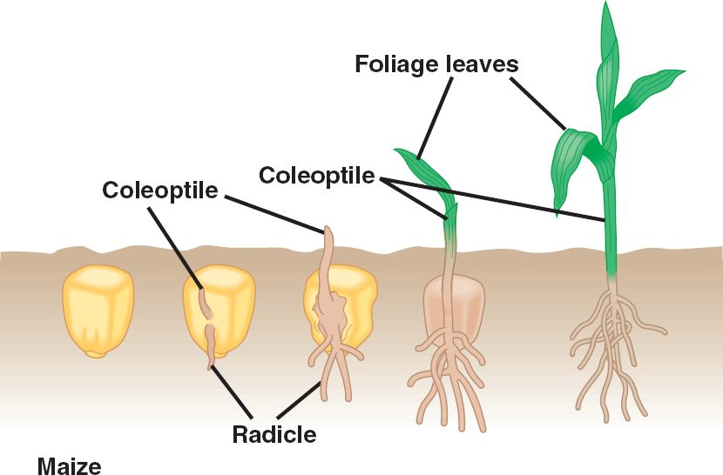

Slide 21
Dicots have two cotyledons – germination takes place in one of two ways:
i. Cotyledons emerge aboveground protecting the stem and first foilage leaves – cotyledons may then wither and drop off the plant or become photosynthetic such as in the pumpkin.
ii. Cotyledons may stay underground, such as in the garden pea, and provide a food source for the growing seedling. The young stem grows longer and forms an arch that protects the delicate shoot tip.

Slide 22
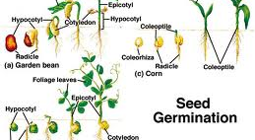

Slide 23
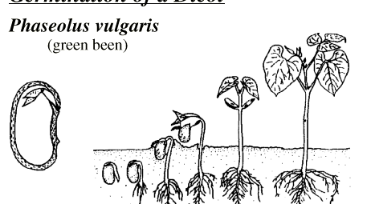

Slide 24
24-3 Plant Propagation and Agriculture
Next class.

