Slide 1
CHAPTER 23 ROOTS, STEMS AND LEAVES
FUNCTION OF ROOTS
FUNCTION OF STEMS
FUNCTION OF LEAVES

Slide 2
PLANT TISSUE SYSTEMS
DERMAL TISSUE
VASCULAR TISSUE
GROWTH TISSUE

Slide 4
DERMAL TISSUE
-outer covering of a plant consists of dermal tissue which consists of layers of epidermal cells.
-dermal tissue is often covered a thick waxy
layer that protects against water loss and injury
- this waxy covering is called the cuticle.
-some epidermal cells have tiny projections called trichomes which help protect the leaf and also give it a fuzzy appearance.

Slide 6
Dermal Tissue continued
In roots dermal tissue includes root hair cells that provide a large amount of surface area and aid in water absorption.
On the underside of leaves, dermal tissue, contains guard cells, which regulate water loss and gas exchange.

Slide 7
VASCULAR TISSUE
Forms a transport system that moves water and nutrients throughout the plant.
Main subsystems – xylem and phloem.
Contains specialized cells called tracheids and vessel elements (xylem); sieve tube elements and companion cells (phloem).
Both xylem and phloem are made up of networks of hollow connected cells that carry fluids throughout the plant

Slide 10
i. Xylem
Seed plants – xylem – tracheid cell
Tracheid cell: long, narrow cells with walls that are impermeable to water.
Openings in the cell wall connect neighboring cells.
When tracheids mature, they die, and their cytoplasm disintegrates.

Slide 11
Seed plants – xylem – tracheid cell
Angiosperm xylem contains tracheid cells AND vessel elements.
-vessel elements are wider than tracheid cells,like tracheid cells they mature and die before they conduct water.
-arranged end to end on top of one another like a stack of tin cans. The cell walls are lost at both ends when the cells die, transforming the stack of vessel elements into a continuous tube tube through which water can move freely.

Slide 12
ii. Phloem
Seed plants – phloem – sieve tube elements
-Sieve tube elements – arranged end to end - like vessel elements, have many small holes in them – materials can move through these holes from cell to cell – as the cells mature they lose their nuclei and most other organelles – the remaining organelles hug the inside of the cell wall – the rest of the space is a conduit thru which sugars and other foods are carried in water.

Slide 14
ii. Phloem
Companion cells are phloem cells that surround sieve tube elements.
-keep their nuclie and other organelles
-support the phloem cellls and aid in mov’t of substances in and out of the phloem.

Slide 15
GROUND TISSUE
Cells that lie btw dermal tissue and vascular tissue make up the ground tissue – parenchyma cells -have thin cell walls and large central vacuoles surr by a thin layer of cytoplasm.
In leaves parenchyma cells are stacked with chloroplasts – site of photosynthesis.
Ground tissue may also contain two other types of cells which have a thicker cell wall:
-collenchyma cells -sclerenchyma cells

Slide 16
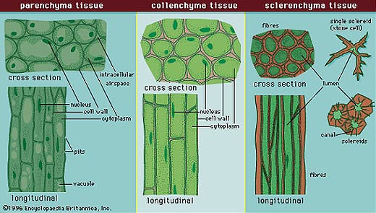
-collenchyma cells -support cells – make up the strings of a stalk of celery.
-sclerenchyma cells – make ground tissue tough and strong.

Slide 17
Plant Growth and Meristematic Tissue pp582 - 583
Will do later.

Slide 18
23-2 ROOOTS
two main types of roots – taproots – found mainly in dicots and fibrous roots which are found in monocots.
1. Taproot – the primary root grows long and thick while the secondary roots remain small.
Ex. Carrots, dandelions, beets and radishes - have thick taproots that store sugars and starches.

Slide 19
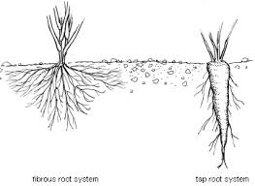
Fibrous roots – branch to such an extent that no single root grows larger than the rest – helps prevent topsoil from being washed away by heavy rain.
Ex. grasses

Slide 20
Root Structure and Growth
Root tissues
Root hairs
Cortex
Endodermis
Vascular cylinder
Root cap

Slide 21
ROOT FUNCTIONS pp586-588
Anchors a plant in the ground and absorb water and dissolved nutrients from the soil.
Essential Plant Nutrients – Nitrogen, Phosphorus, Potassium, Magnessium, Calcium
Refer to chart on page 586

Slide 22
Root Function continued
Important concepts:
i. Uptake of Plant Nutrients
Ii. Active transport of Minerals
Iii. Movement into the vascular cylinder
Iv. Osmosis
V. Root pressure

Slide 23
23-3 STEMS pp589-594
Stem Structure and Function:
-contains 3 tissues – g.t., v.t., d.t.
3 Important functions
i. Produce leaves, branches and flowers
ii. Hold leaves up to the sunlight.
iii. Transport substances btw roots and
leaves.

Slide 24
STEMS continued
Nodes are where leaves are attached.
Internodes are regions btw the nodes
Buds develop where leaves attach to the stem and contain underdeveloped tissue that can produce new stems and leaves.
Woody tissue is developed by stems.

Slide 25
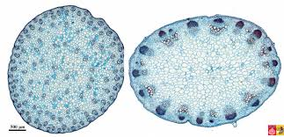
Stems continued
Monocot stems – vascular bundles are scattered thruout the stem
Dicot stems and most gymnosperms vascular bundles are arranged in a cylinder.

Slide 26
GROWTH OF STEMS pp590-591
Primary growth – apical meristem – increases length of plant
Secondary growth – lateral meristematic tissue – increases thickness of plant
-vascular cambium
-cork cambium

Slide 27
FORMATION OF WOOD, FORMATION OF BARK pp592-593
Assignment for next class determine how wood and bark are formed – from which tissues – is there a meristem involved?

Slide 28
STEMS ADAPTED FOR STORAGE AND DORMANCY p594
Tubers, rhizomes, bulbs, corms can remain dormant during cold or dry periods until favorable conditions for growth return.
Potato – tuber , ginger – rhizome, crocus bulb – corm, tulip bulb – bulb.

Slide 29
23-4 LEAVES pp595-598
Leaf structure:
-blades
-petiole
-mesophyll
- palisade mesophyll
- spongy mesophyll
-stomata
-guard cells.

Slide 30
Transpiration and Gas Exchange pp596-597
What is transpiration?
Where and how does gas exchange occur?
What factors regulate the opening and closing of stomata?
What is the function of guard cells?

Slide 31
23-5 TRANSPORT IN PLANTS pp599-602
How is water transported through a plant?
Adhesion
Capillary action
Root pull
Transpiration
What causes wilting?
What is the pressure flow hypothesis?

Slide 32
PLANT GROWTH AND MERISTEMATIC TISSUE pp582-583
VOCABULARY:
meristems, meristematic tissue, apical meristem and
differentiation, root apical meristem, Root cap and
Zone of cell division, Z of elongation , Z of maturation

