Slide 1
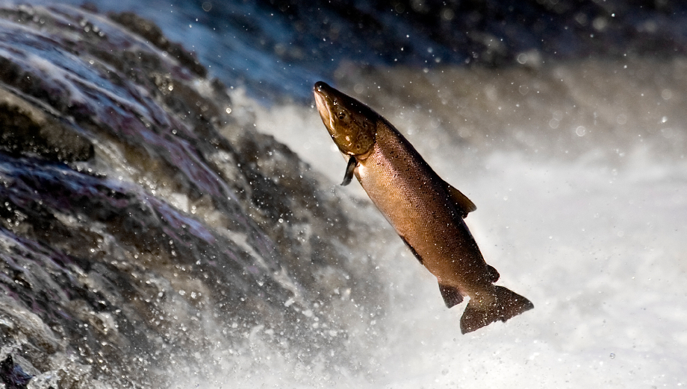
4-2 What shapes an ecosystem? Part 1
Notes:
Photo Credit: ©Bruce Coleman, LTD/Natural Selection

Slide 2
Ecology concepts 4.2 What shapes an Ecosystem? (p90-93)
Lecture Outline
Biotic and Abiotic Factors
The Niche
Community Interactions
Competition, predation, symbiosis, mutualism, commensalism, parasitism

Slide 3
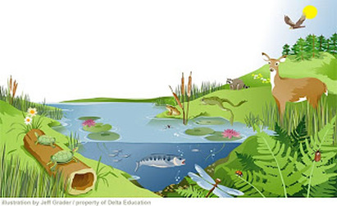
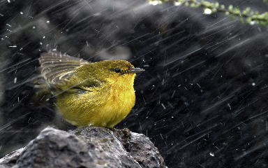
Biotic and Abiotic Factors (p90)
Biotic and Abiotic Factors
Ecosystems are influenced by a combination of biological and physical factors.
Biotic: biological factors
Abiotic: physical, or non living factors

Slide 4
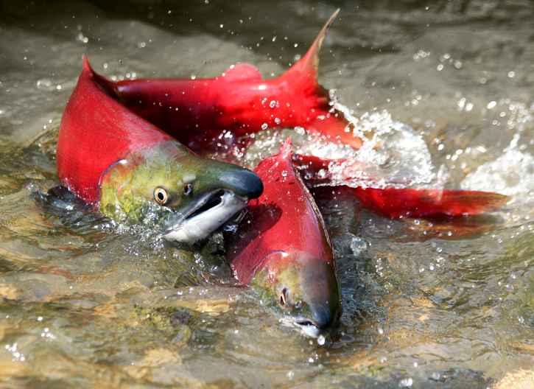
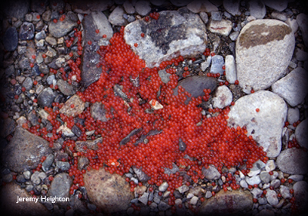
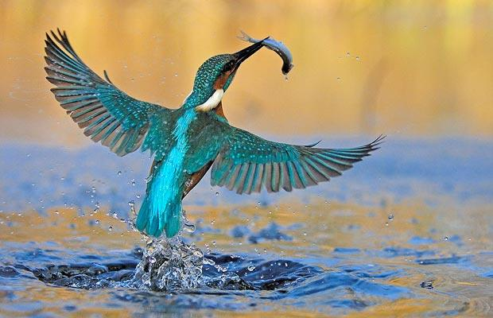
Biotic and Abiotic Factors
Together, biotic and abiotic factors determine the survival and growth of an organism and the productivity of the ecosystem in with the organism lives.
The area where an organism lives is called its habitat. A habitat includes both biotic and abiotic factors.
Like any organism, the sockeye salmon encounters and uses many biotic and abiotic factors during its life.

Slide 5
Biotic and Abiotic Factors of Sockeye Salmon EXERCISE
→ Identify the biotic and/or the abiotic factor(s) in these statements
1. After fertilization of the eggs by the male, the female covers the eggs with gravels to protect them from predation.
2. Once they reach the food-rich ocean, salmons feed and grow quickly, reaching an average weight of 3 kg. They follow Arctic currents to Alaska.
3. To find their way home, salmons use both sun and earth’s magnetic field to navigate through the ocean. Near freshwaters, their smell helps them finding mates, identify kin and predators.
4. In the Fraser River, returning salmons face a punishing upstream journey in the face of opposing currents and rapids.

Slide 6
Biotic and Abiotic Factors (p90)
Physical, or nonliving, factors that shape ecosystems are called abiotic factors.
Abiotic factors include:
temperature
precipitation
humidity
wind
nutrient availability
soil type
sunlight

Slide 7
The Niche (p91)
A niche is the full range of physical and biological conditions in which an organism lives and the way in which the organism uses those conditions.
A few examples of what a niche includes:
its place in the food web
the range of temperatures that the organism needs to survive
the combination of the biotic and abiotic factors in an ecosystem
the type of food the organism eats, how it obtains food and which other species predate the organism
when and how it reproduces
...

Slide 8
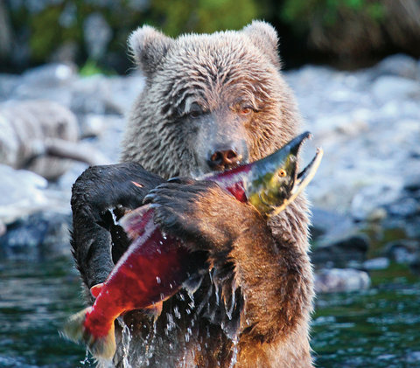
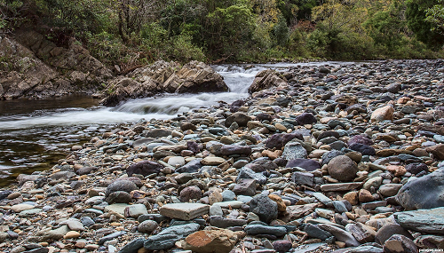
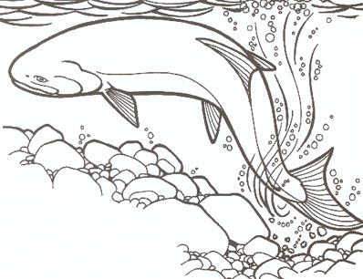
The Niche vs Habitat
What is the difference between the niche and the habitat of an organism?
The habitat includes only biotic and abiotic factors of the area where the organism lives.
The niche includes the habitat and also the way in which the organism uses the conditions of the area.
Two species can live in the same habitat, but they can not have the exact same niche.

Slide 9
Community interactions (p92-93)
When organisms live in the same ecological communities, they interact constantly.
Types of interactions:
Competition
Predation
Symbiosis
Mutualism
Commensalism
Parasitism

Slide 10
Community interactions (p92-93)
Competition
Competition occurs when organisms of the same or different species attempt to use an ecological resource in the same place at the same time.
A resource is any necessity of life, such as water, nutrients, light, food, or space.

Slide 11
Community interactions (p92-93)
Competition
Competition occurs when organisms of the same or different species attempt to use an ecological resource in the same place at the same time.
A resource is any necessity of life, such as water, nutrients, light, food, or space.
Direct competition in nature often results in a winner and a loser—with the losing organism failing to survive.
The competitive exclusion principle states that no two species can occupy the same niche in the same habitat at the same time.

Slide 12
Community interactions (p92-93)
Predation
An interaction in which one organism captures and feeds on another organism is called predation.
The organism that does the killing and eating is called the predator, and the food organism is the prey.

Slide 13
Community interactions (p92-93)
Symbiosis
Any relationship in which two species live closely together is called symbiosis (“living together”).
Symbiotic relationships include:
Mutualism: both species benefit from the relationship.
Commensalism: one member of the association benefits and the other is neither helped nor harmed.
Parasitism: one organism lives on or inside another organism and harms it.

Slide 14
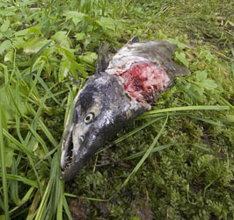
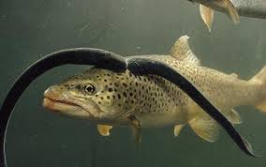
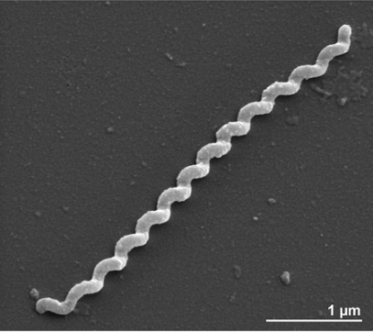
Community interactions (p92-93)
Identify the type of interaction:
A bacteria called spiochaete lives in the digestive system of the salmon and it helps the fish to digest its food.
A lamprey is a fish that attaches itself to another fish to suck its blood.
After finishing his meal, an eagle dropped a salmon carcass in the forest. A tree uses the nutrients that the carcass gives.

Slide 15
Community interactions (p92-93) EXERCISE
Identify the type of symbiosis:
4. Video: Odd Couple - Fish and Shrimp's symbiotic relationship (1min):
https://www.youtube.com/watch?v=GdC0Akpa2ts

