Slide 1
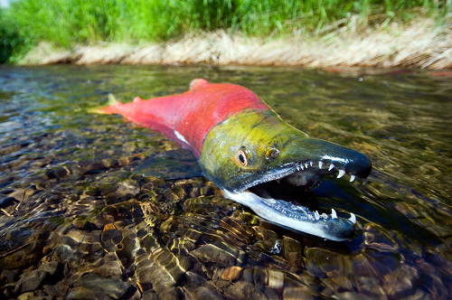
Sockeye Salmon of the Adams River, BC
www.thinksalmon.com
www.salmonsociety.com
www.fish4thefuture.com
www.tourismkamloops.com

Slide 2
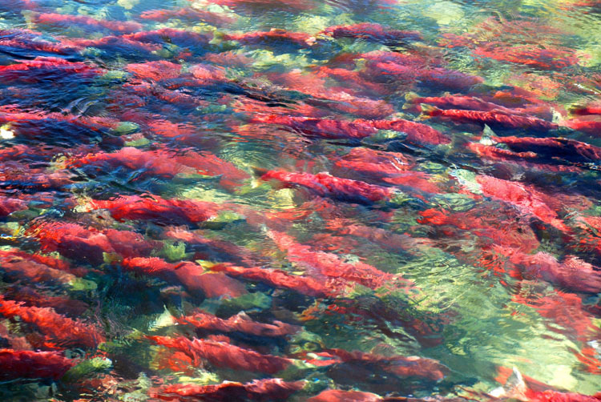
The ritual of sockeye salmon
Sockeye salmons are anadromous: Fish that migrate from salt water to freshwater to spawn
Each summer, millions of Pacific salmons make incredible migrations between North Pacific and freswaters of their birth of spawn.
Adams River, BC: One of the most important sockeye salmon breeding areas in North America

Slide 3
The ritual of sockeye salmon
Salmon ecology is so important that it will to teach us about different concepts of Ecology
3.1 What is Ecology? (p63-64)
Interactions and interdependence
Levels of organization
3.2 Energy flow (p67-73)
Producers, Consumers
Food chains, Food webs
Ecological pyramids
4.2 What shapes an Ecosystem? (p90-93)
Biotic and Abiotic factors, the niche
Community Interactions

Slide 4
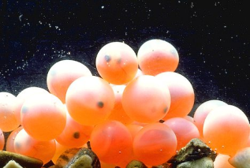
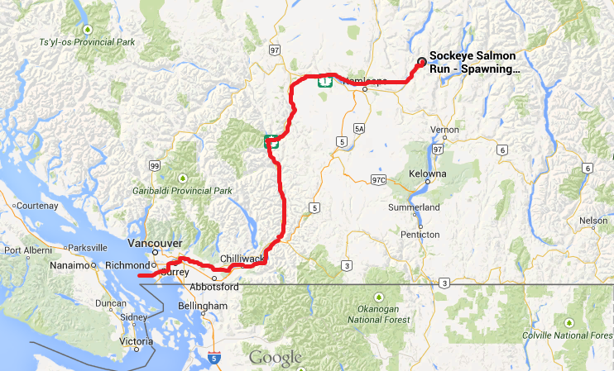
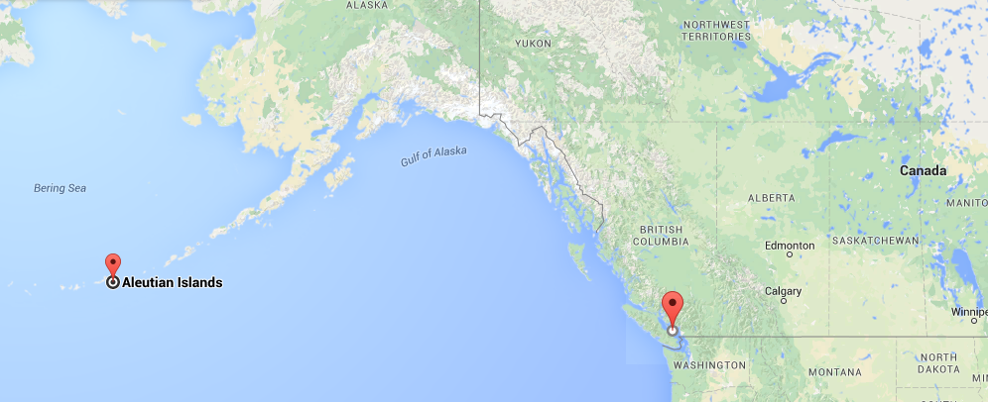
The ritual of sockeye salmon
Sockeye salmons are born in the Adam Rivers.
They travel to Strait of Georgia to reach the Pacific Ocean
They spend 3 years in the open ocean following Arctic currents to Alaska
They then retrace their way to Adams River to breed
round trip of 4000km!

Slide 5
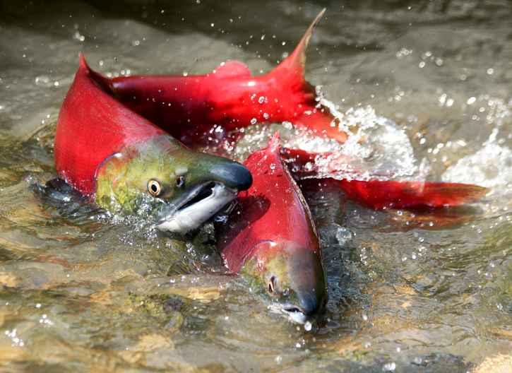
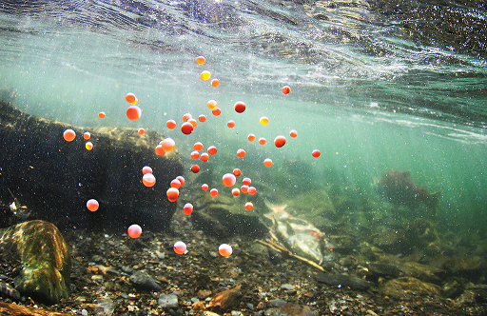
The ritual of sockeye salmon
Spawning – at Adams River, in October
Male and female fish pair and spawn along the length of the river.
Females lay about 4000 eggs.
After spawning, the salmons die.
Some eggs are fertilized, some eggs are eaten by rainbow trout and other predators.

Slide 6
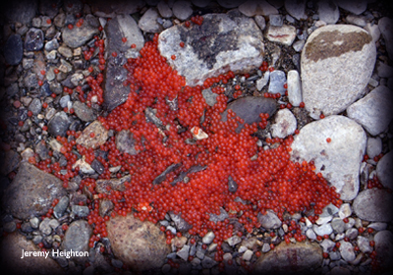
The ritual of sockeye salmon
Egg life – at Adams River, during winter
Fertilized eggs spend the winter on the river bed, sheltered from predators and frost by a thin layer of gravel.
They gain in size and nourished by their yolk sacs.

Slide 7
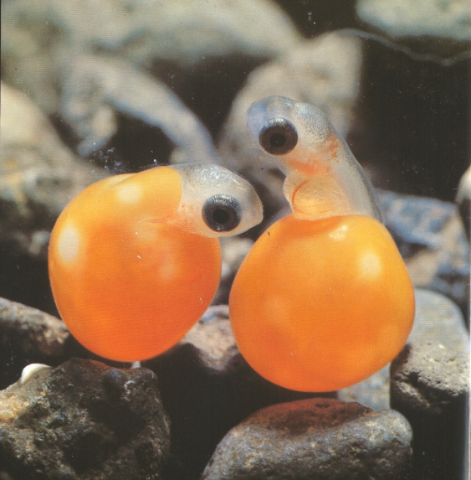
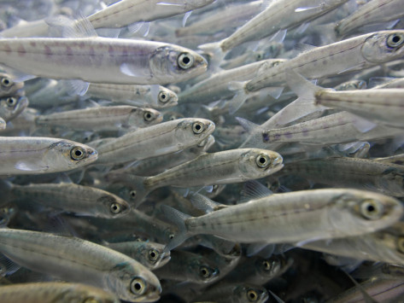
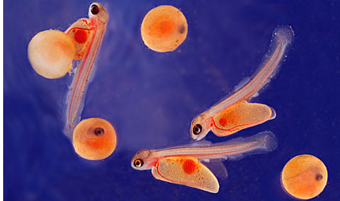
The ritual of sockeye salmon
Hatching – at Adams River, in spring
Eggs hatch and salmon fry emerge (~2,5 cm).
They spend first year in lakes. First destination of Adams River sockeye is nearby Shuswap Lake.
Hatching embryo → Alevin → Fry → Smolt

Slide 8
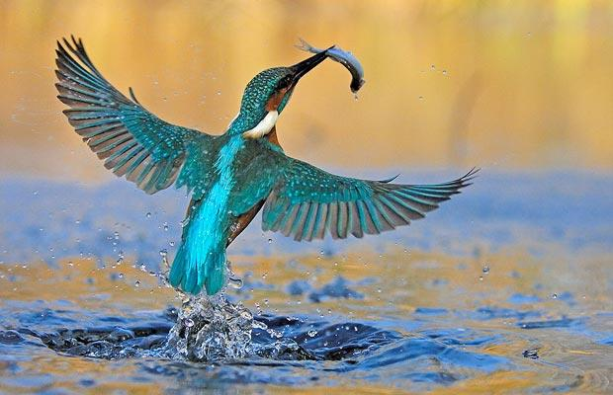
The ritual of sockeye salmon
Smolt life – Lakes to Pacific Ocean
3 out of 4 salmon fry will be eaten by predators before they leave the lake.
The survivors are now smolts (~7.5 to 10 cm) and begin a 290km journey downstream to the mouth of the Fraser River and beyond into the salt water of the Pacific Ocean

Slide 9
The ritual of sockeye salmon
Reaching maturity – Pacific Ocean (for 3 years)
The hearty survivors are now sleek and silver coloured.
Once they reach the food-rich ocean, salmons feed and grow quickly, reaching an average weight of 3 kg.
They follow Arctic currents to Alaska.

Slide 10
The ritual of sockeye salmon
Coming back home – From Pacific Ocean to Adams River
3 years later (4 years after hatching), sockeye salmons reach maturity and a genetic signal from within tells them to begin the journey home.
To find their way home:
They use both sun and earth’s magnetic field to navigate through the ocean.
Near freshwaters, they rely on both their amazing sense of smell and the map of scents memorized to navigate home (their smell also helps them finding mates, identify kin and predators)
nostril

Slide 11
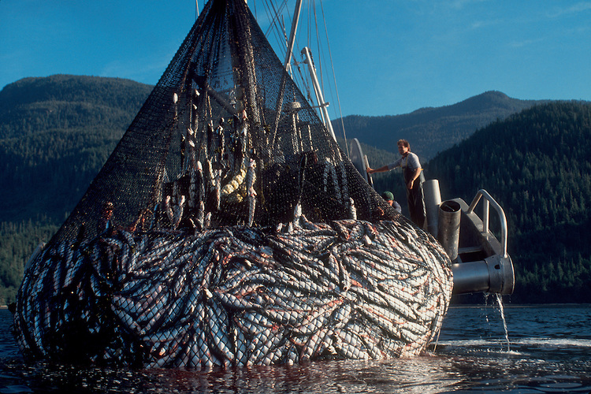
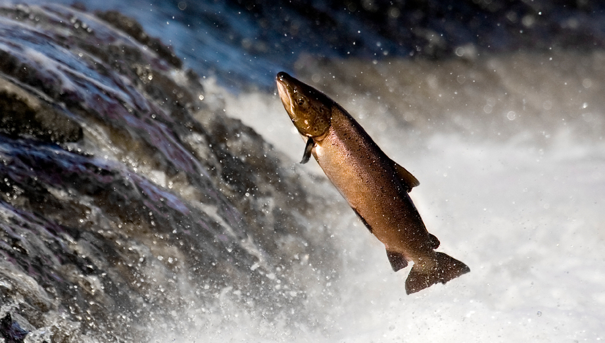
The ritual of sockeye salmon
Challenging return – From Pacific Ocean to Adams River
As the sockeye swim back toward their spawning grounds, they must dodge commercial, recreational and First Nation fisheries.
But their biggest obstacles remain: in the Fraser River, returning salmons face a punishing upstream journey in the face of opposing currents and rapids.

Slide 12
The ritual of sockeye salmon
Challenging return – From Pacific Ocean to Adams River
Swimming at an average of 29km per day, the fish take about 18 days to cover the distance from the mouth of the Fraser to their spawning grounds.
They finally arrive battered and torn from their trek.
Only 2 adult survivors for every 4000 eggs deposited 4 years ago survived and are ready to complete the cycle.

Slide 13
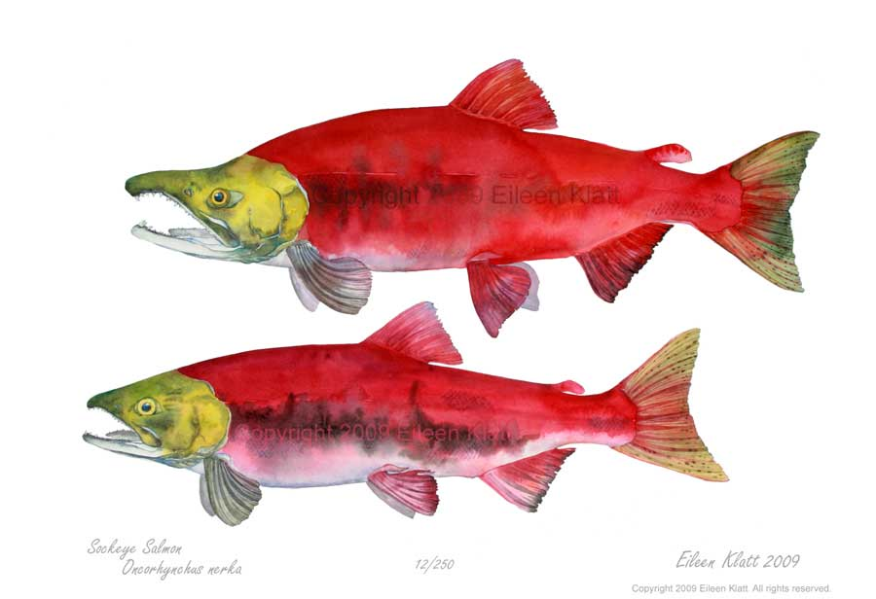
The ritual of sockeye salmon
Final physical changes – Back to Adams River
Their skin as taken the deep red colour characteristic of spawning sockeye
Their head then turns green
The males develop humped backs and hooked snouts
Female bellies swell with thousands of eggs
male
female
ocean salmon
spawning salmons

Slide 14
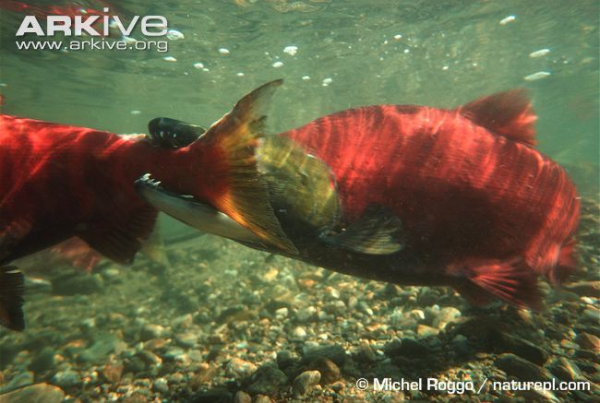
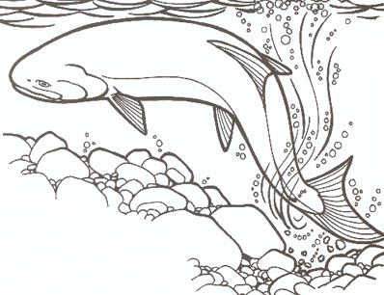
The ritual of sockeye salmon
Reproduction – Back to Adams River, in October, 4 years later
In shallow gravel beds, male and female fish pair and spawn along the length of the river.
The males use their big teeth to fight off other contenders.
The female digs a nest (called a redd) by flapping her tail and drops some of her eggs.

Slide 15
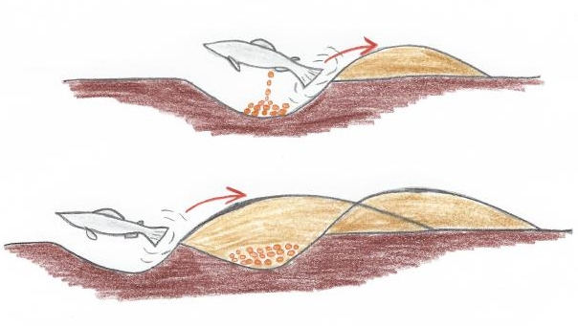
The ritual of sockeye salmon
Reproduction – Back to Adams River, in October, 4 years later
The male then fertilizes (externally) the eggs with a shower of milt and the female covers the eggs with gravels.
Pairs of fish then swim upstream and repeat the process until they are exhausted and die. If the female dies first, the male pairs again.

Slide 16
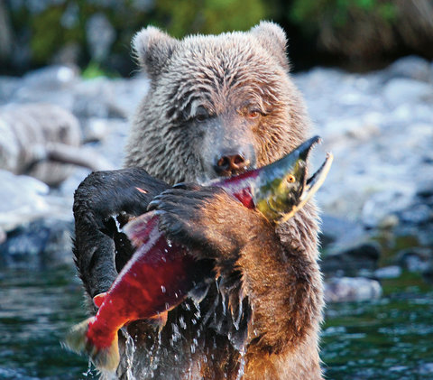
The ritual of sockeye salmon
Predators – Back to Adams River, in October, 4 years later
Eagles, ospreys and other birds swoop down to pick up the dead fish that litter the shallows.
Minks, coyotes and bears prowl the banks to get their share.
By mid-November, the river returns to its former tranquility.

Slide 17
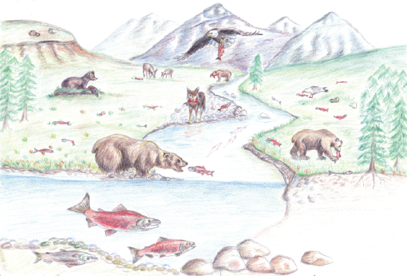
Sockeye salmon is a “keystone” species
Keystone species: Species that have a large impact on its environment
Anadromous salmons are a keystone species in both aquatic and terrestrial environments. This means that they influence survival or reproduction of other species.
Returning salmons transport millions of tons of nutrients from the nutrient rich marine environment to the nutrient poor ecosystems of the Adams River.
This increases production at all levels of the food chain, from bacteria and algae communities to top predators, such as bears.

Slide 18
Sockeye salmon is a “keystone” species
More than 40 species of vertebrates directly benefit from annual salmon runs by:
feasting on salmons, eggs, youngs, carcasses
Salmons are so important for coastal brown bears that greater salmon consumption is associated with larger bear size and more offspring.
Predators and scavengers also transport salmon nutrients into forests
it gives nutrients to plants, fungi, bacteria

