Slide 1
Chapter 22
Introduction to Plants

Slide 2
What is a Plant?
-multicellular eukarotes
-cell walls made up of cellulose
-carry out photosynthesis
-pigment is chlorophyll a and b
-most are autotrophs but a few are parasitic or saprobes.
Plants include trees, shrubs, grasses, mosses and ferns.

Slide 3
What Do Plants Need to Survive?
Sunlight
Water and minerals
Gas exchange
Movement of nutrients and water

Slide 4
!. Plants must be able to capture the sun’s energy.
The leaves of a plant are where photosynthesis occurs.
LEAVES
are organized for maximum light absorption
Notes:
Leaves come in different shapes and sizes

Slide 5
Plants must be able to obtain water and nutrients from the soil.
This is done through the roots of a plant.

Slide 6
Plants must be able to transport water and nutrients from the roots of a plant to all the cells found in a plant.
This is done through osmosis and diffusion in algae nonvascular plants such as mosses; through vascular tissue in all other plants.

Slide 7
Plants need to be able to obtain CO₂ and release O_{2.} (gas exchange)
Gas exchange occurs in the leaves of a plant.

Slide 8
Why is gas exchange necessary?
Photosynthesis:
CO₂+H₂0 --→ C₆H₁₂0₆ + O₂

Slide 9
Plants take up water and nutrients through their roots and make food in their leaves.

Slide 10
Vascular tissue
-is a type of plant tissue specialized to conduct water and nutrients throughout a plant.
-xylem – carriers water upwards from the roots to every part of a plant
-phloem- carriers nutrients and the carbohydrates produced by photosynthesis through the plant

Slide 11
OVERVIEW OF THE PLANT KINGDOM
PAGE 555 OF TEXT
760 SPECIES OF CONE BEARING PLANTS
11,000 SPECIES OF FERNS AND RELATIVES
15,600 SPECIES OF MOSSES AND RELATIVES
235,000 SPECIES OF FLOWERING PLANTS

Slide 12
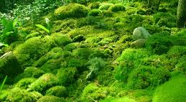
Phylum BRYOPHYTE

Slide 13
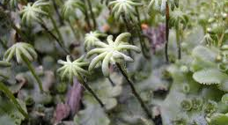
Liverwort

Slide 14
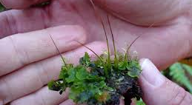
Hornwort

Slide 15
Bryophytes
-nonvascular plants ( have no vascular tissue)
-well adapted to wet, nutrient poor soil.
-can tolerate low temperatures
-can grow in harsh conditions where other plants can’t grow
-are the most abundant plant in the polar regions.

Slide 16
Phylum BRYOPHYTES
Unique features:
depend on water for reproduction
lack vascular tissue therefore lack true roots, stems and leaves.
Low growing.
Leaves are one cell thick.

Slide 17
Why are bryophytes smaller than other types of plants?

Slide 18
Why are bryophytes smaller than other types of plants?
lack of vascular tissue
Nutrient transport within bryophytes is limited by diffusion being the means of transporting nutrients within the plant.

Slide 19
Life Cycle of a Bryophyte (Moss)
Two generations
Dominant generation is the gametophyte –is the stage that carries out most of the plant’s photosynthesis. Gametophytes produce gametes.
- least dominant generation is the sporophyte – produces haploid spores, grows at the top of the gametophyte plant.
-p558 text.

Slide 20
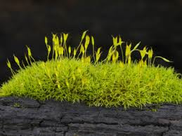

Slide 21
Gametophyte
Is haploid (n)
Develops from a moss spore.
A moss spore lands in a moist place, it germinates and grows into a mass of tangled filaments called a protonema.
as the protonema grows it forms rhizoids that grow into the ground and shoots that grow into the air.

Slide 22
The shoots grow into the green moss plant, which is the gametophyte stage of its life cycle.

Slide 23
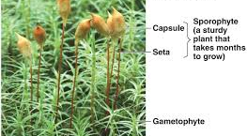

Slide 24
Gametophyte continued
Gametes are formed in reproductive structures at the tips of the gametophyte.
-Antheridia is where the sperm are
produced.
-Archegonia is where the egg is
produced.
Some species produce both sperm and egg on the same plant.

Slide 25
Gametophyte continued
Once sperm are released and reach egg cells, fertilization produces a diploid zygote.
the zygote is the beginning of the sporophyte stage of the life cycle. It grows directly out of the body of the gametophyte and depends on it for water and nutrients.

Slide 26
SPOROPHYTE
Diploid (2n)
Grows out of the gametophyte.
Dependent on the gametophyte for water and nutrients.
A mature sporophyte is a long stalk ending in a capsule.
Inside the capsule, haploid spores are produced by meiosis.
When the capsule ripens, it opens and haploid spores are scattered. The cycle begin again.

Slide 27
HUMAN USES OF MOSSES
★Most mosses can absorb many times their own weight in water and therefore act as a natural sponge.
★In certain environments the dead remains of sphagnum moss accumulates to form thick deposits of peat.
-Peat can be cut from the ground and used as a fuel.

Slide 28
Assignment 1 Due next class
Draw, color and label the life cycle of a moss.
Include the following terms:
Gametophyte, saprophyte, haploid, diploid, n, 2n, meiosis, sporangium, spores, protonema, female gametophyte, male gametophyte, archegonia, antheridia, egg, sperm , zygote

