Slide 1
Chapter 28: Arthropods
Crustaceans
Spiders
Insects

Slide 2
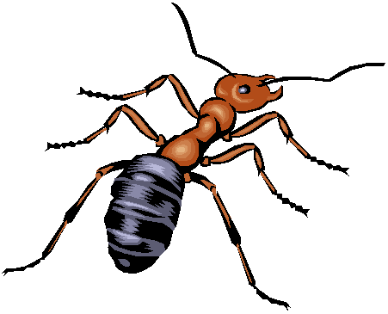
ARTHROPODS
Segmented body
Tough exoskeleton
Jointed appendages

Slide 3
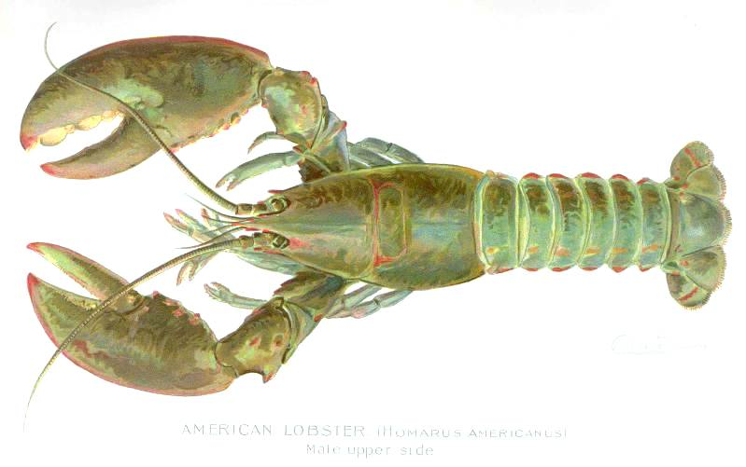
SEGMENTED BODY
Crustaceans – two or three body sections and chewing mouth parts called mandibles.

Slide 4
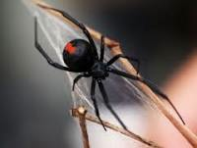
SPIDERS – two body segments, mouth parts called chelicerae

Slide 5
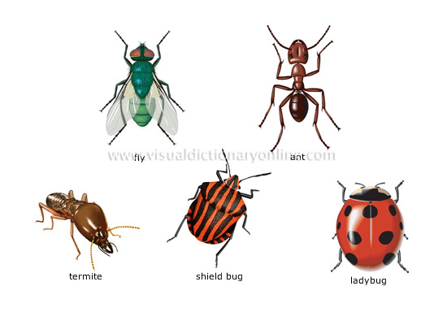
INSECTS – three part bodies; insects; have jaws.

Slide 6
EXOSKELETON – made of protein and the carbohydrate chitin; protects and supports the body of the arthropod; vary in size, shape and toughness.
Crustaceans
Spiders
Insects -

Slide 7
APPENDAGES – are structures such as legs and antennae that extend from the body wall. Appendages are jointed – “arthron” means “joint” in Greek, “podos” means “foot”
Crustaceans – two pairs of antennae, number of walking legs varies.
Spiders – most have four pairs of walking legs, no antennae.
Insects – one pair of antennae and 3 pairs of unbranched appendages

Slide 8
Crustacean – crabs, shrimps, lobsters, crayfish, barnacles
Spiders - horseshoe crabs, spiders, ticks and scorpions
Insects – beetle, fly, ant, termite, ladybug, moth, bees, wasps

Slide 9
Form and Function in Arthropods
Feeding – incl herbivores, carnivores and omnivores; bloodsuckers, filter feeders, detritivores and parasites.
Mouthparts range from pincers or fangs to jaws.

Slide 10
Respiration:
Terrestrial arthropods –
Most breath through a network of branching tracheal tubes that extend throughout the body. Air enters and leaves the tracheal tubes through spiracles which are small openings located along the side of the body.
Some arthropods such as spiders breath through Book lungs which are organs that have layers of respiratory tissue stacked like the pages of a book.

Slide 11
Aquatic arthropods - such as lobster, crabs, respire through gills.
Refer to page 753 to view the different types of respiratory organs.

Slide 12
Circulation – open circulatory system; well developed heart pumps blood through arteries that branch and enter tissues. Blood leaves the vessels and moves through sinuses. The blood then collects in a large sinus surrounding the heart and re-enters the heart and is again pumped through the body.
Refer to page 754

Slide 13
Excretion
Terrestrial arthropods - dispose of nitrogenous wastes using Malpighian tubules which are sac like organs that extract wastes from the blood and then add them to the digestive waste.
Aquatic arthropods – diffusion moves cellular wastes from the animals body into the surrounding water.
Refer to page 755

Slide 14
Response – most arthropods have a well developed nervous system; all have a brain; most have sense organs – ex. Compound eyes ( may have more than 2000 different lenses – can detect color and motion)
Movement – move by using well developed groups of muscles that are controlled by the nervous system. Muscle cells can contract, they generate force by contracting and then pulling on the exoskeleton

Slide 15
-at each body joint, different muscles either flex (bend) or extend (straighten) the joint.
Reproduction
Terrestrial arthropods – internal fertilization
Aquatic arthropods – internal or external fertilization.

Slide 16
Growth and Development in Arthropods
An exoskeleton does not grow as the animal grows, therefore, when the animal outgrows its exoskeleton it undergoes a period of molting. During molting the entire exoskeleton is shed and a new larger skeleton is formed.

Slide 17
Crustaceans
The Crayfish
Cephalothorax - head and thorax – houses most of the internal organs. The cephalothorax is covered by an exoskeleton called the carapace.
Abdomen – is the posterior part of the body

Slide 18
Appendanges – the first two pairs are antennae which bear many sensory hairs. In crayfish, antennae are primarily sense organs. In other crustaceans they are used for feeding or swimming.
-3rd pair of appendages are mandibles which are mouthparts adapted for biting and grinding food.
-gills are attached to the appendages associated with the cephalothorax.

Slide 19
Continue p 721

