Slide 1
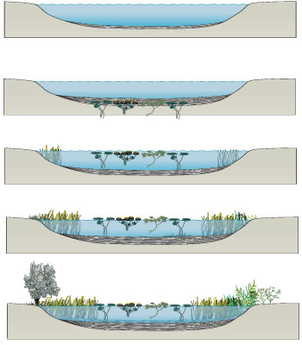
4-2 What shapes an ecosystem? Part 2 : Ecological Succession
Notes:
Photo Credit: ©Bruce Coleman, LTD/Natural Selection

Slide 2
Ecology concepts Ecological Succession (p94-97)
Lecture Outline
Ecological Succession
Primary succession, secondary succession

Slide 3
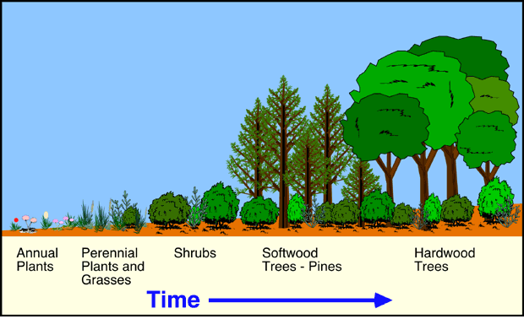
Ecological Succession
This series of predictable changes that occurs in a community over time is called ecological succession.
Sometimes, an ecosystem changes in response to an abrupt disturbance.
At other times, change occurs as a more gradual response to natural fluctuations in the environment.
Forest
succession
Bog
succession

Slide 4
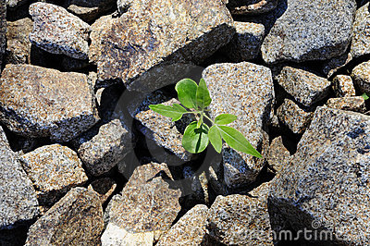
Ecological Succession
Primary Succession
On land, succession that occurs on surfaces where no soil exists is called primary succession. For example, primary succession occurs on rock surfaces formed after volcanoes erupt.
The first species to populate the area are called pioneer species.

Slide 5
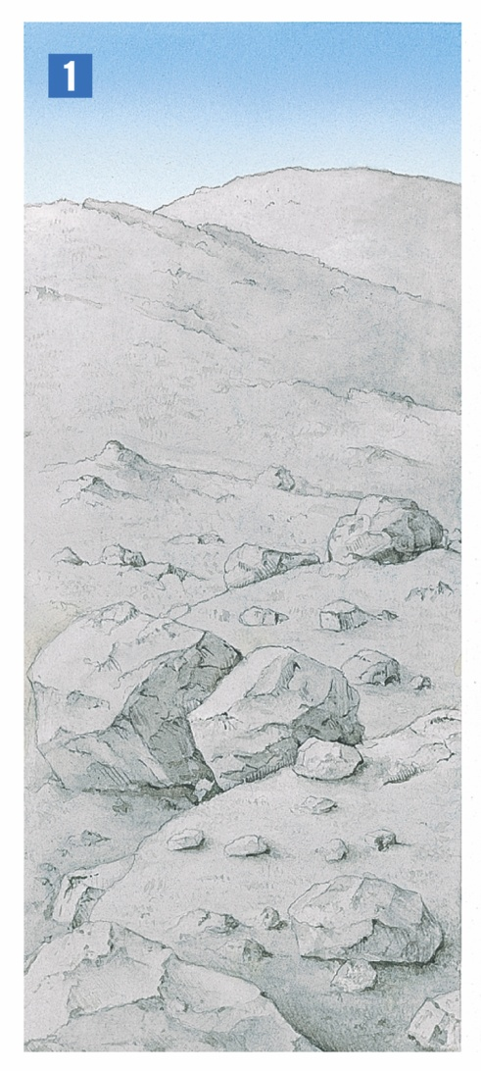
Ecological Succession
In this example, a volcanic eruption has destroyed the previous ecosystem.
Notes:
Primary succession occurs on newly exposed surfaces, such as this newly deposited volcanic rock and ash.

Slide 6
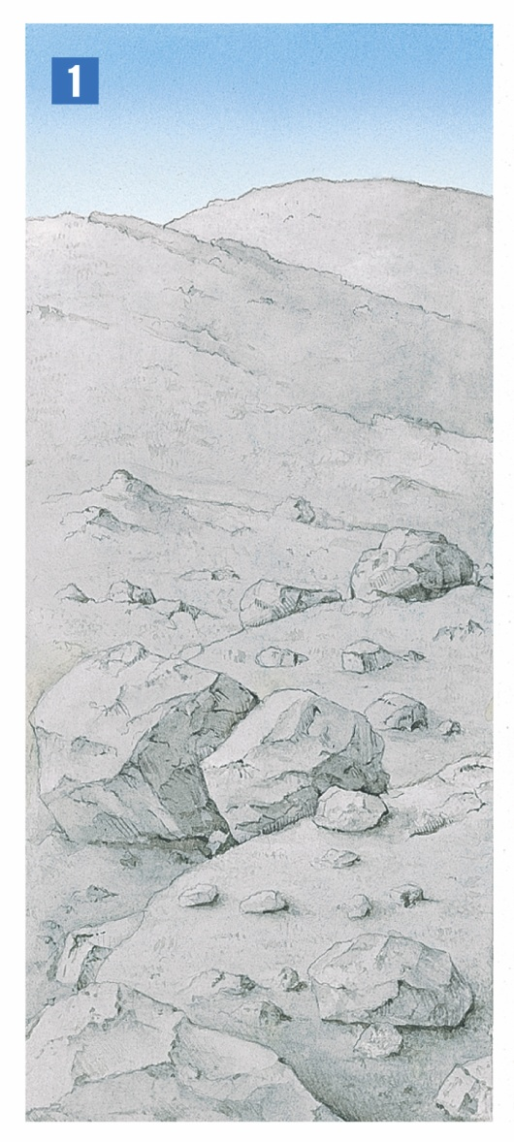
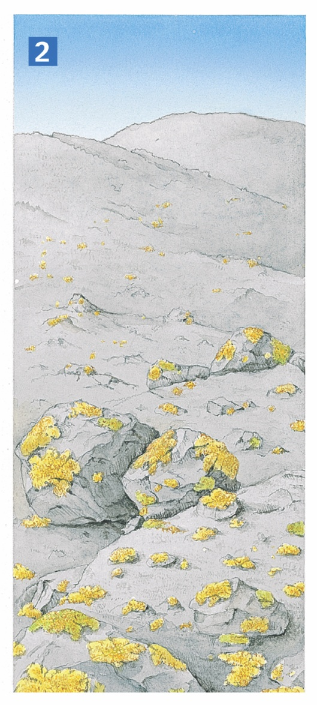
Ecological Succession
The first organisms to appear are lichens.
Notes:
Primary succession occurs on newly exposed surfaces, such as this newly deposited volcanic rock and ash.

Slide 7
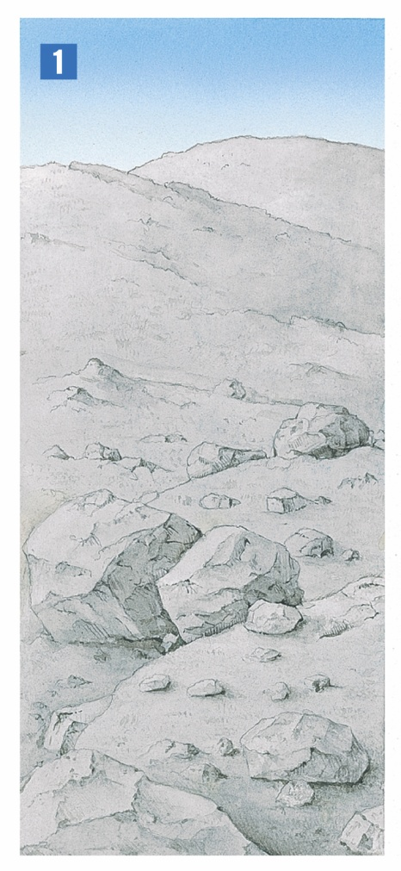
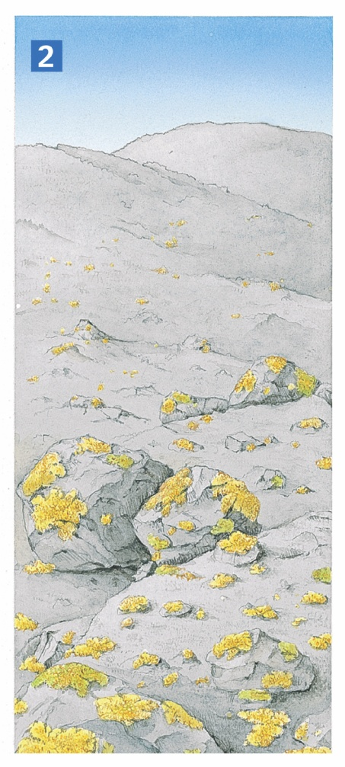
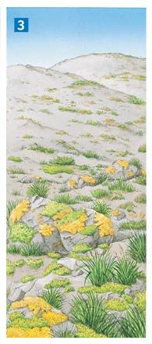
Ecological Succession
Mosses soon appear, and grasses take root in the thin layer of soil.
Notes:
Primary succession occurs on newly exposed surfaces, such as this newly deposited volcanic rock and ash.

Slide 8
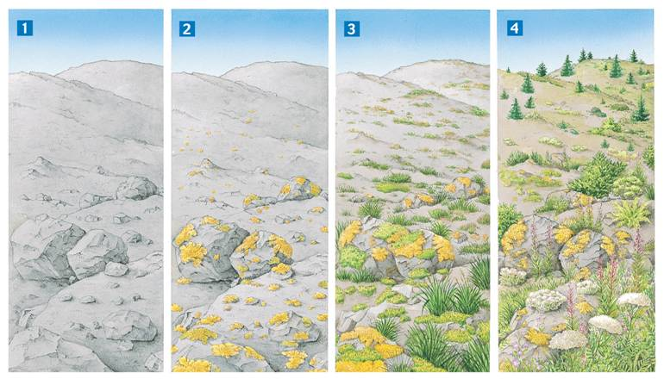
Ecological Succession
Eventually, tree seedlings and shrubs sprout among the plant community.
Notes:
Primary succession occurs on newly exposed surfaces, such as this newly deposited volcanic rock and ash.

Slide 9
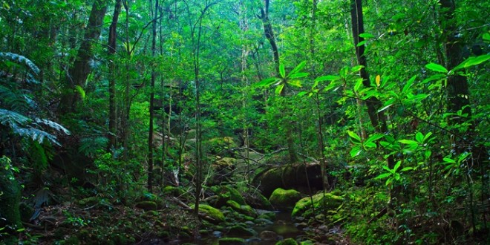
Ecological Succession
Secondary Succession
Components of an ecosystem can be changed by natural events, such as fires.
When the disturbance is over, community interactions tend to restore the ecosystem to its original condition through secondary succession.

Slide 10
Ecology Succession and bogs
See lab manual:
p. 40 – 44
Fill the blanks

