Slide 1
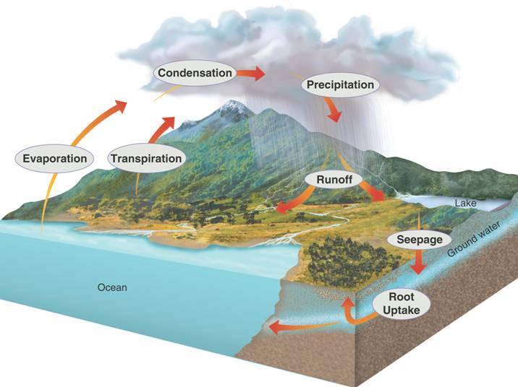
3–3 Cycles of Matter
How does matter move among the living and nonliving parts of an ecosystem?
Notes:
Photo Credit: ©Bruce Coleman, LTD/Natural Selection

Slide 2
Ecology concepts 3.3 Cycles of Matter (p74 -80)
Lecture outline
- Matter in ecosystems
Water
Carbon
Nitrogen
Phosphorous
- Nutrient limitation

Slide 3
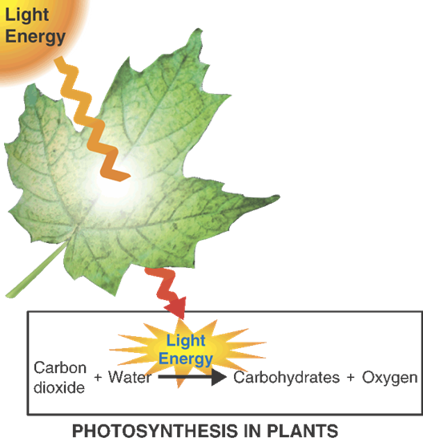
Energy vs Matter (p74 )
Energy and matter move through the biosphere very differently.
Energy (chap. 3.2): one way flow through ecosystems
sun→producers→consumers
- Energy doesn’t get returned to the sun!

Slide 4
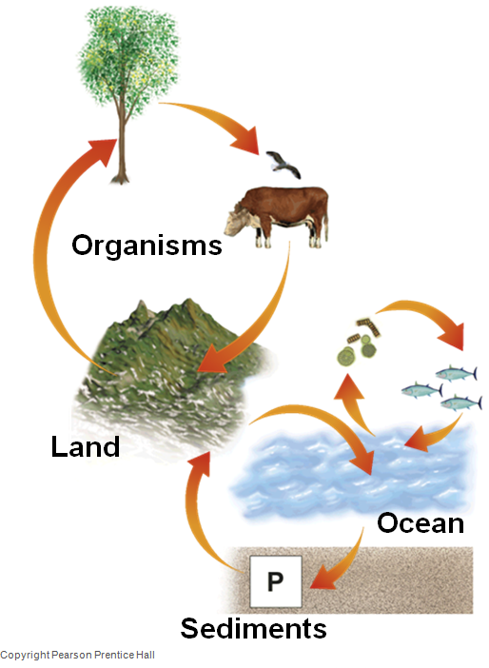
Energy vs Matter (p74 )
Energy and matter move through the biosphere very differently.
Matter is recycled within and between ecosystems in biogeochemical cycles
This is possible because biological systems transform matter but don’t use it up
They transform matter by assembling it into living tissue or passing it out of the body as waste

Slide 5
Energy vs Matter (p74 )
Energy and matter move through the biosphere very differently.
Matter is recycled within and between ecosystems in biogeochemical cycles
This is possible because biological systems transform matter but don’t use it up
They transform matter by assembling it into living tissue or passing it out of the body as waste

Slide 6
The water cycle (p75 )
All living things require water to survive
Water moves between the ocean, atmosphere, and land.

Slide 7
The water cycle
Exercice
Identify the phenomena with the definition:
Water changes from liquid to gas. _________________
Water released from leaves of plants and evaporates. ______________
Water vapour forms tiny droplets that form clouds in the atmosphere. _________________
When the droplets are large enough, the water returns to Earth’s surface. _________________

Slide 8
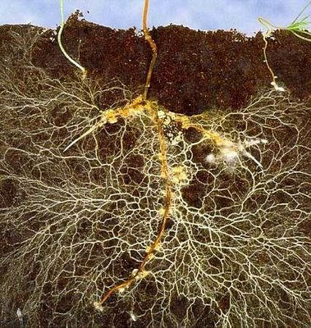
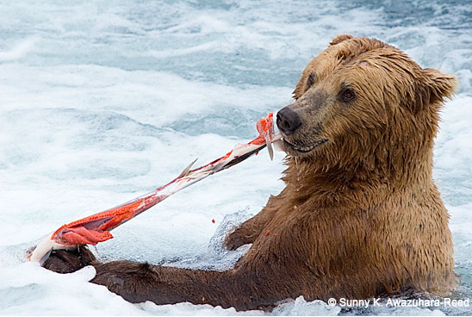
Nutrient cycles (p76 )
Nutrients are the chemical substances that organisms need to sustain life (ex: build tissues).
Similar to water, nutrients are passed between organisms and the environment through biogeochemical cycles
Producers obtain nutrients in inorganic forms from the environment
Consumers obtain nutrients by eating other organisms

Slide 9
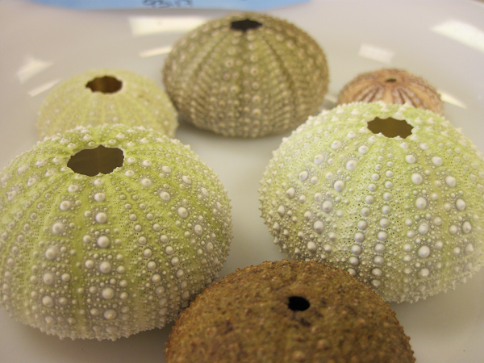
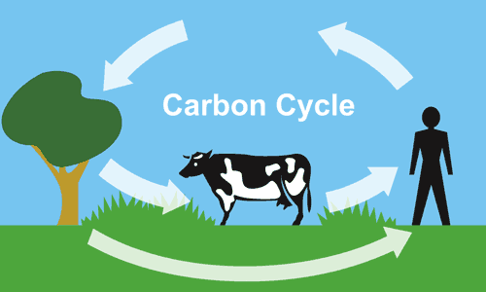
The carbon cycle (p76 )
Carbon is a key ingredient of living tissue
Examples of molecules where carbon (C) is found:
- CaCO₃ (Calcium carbonate) of some animal skeletons
- CO₂ (Carbon dioxide), atmospheric component

Slide 10
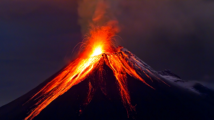
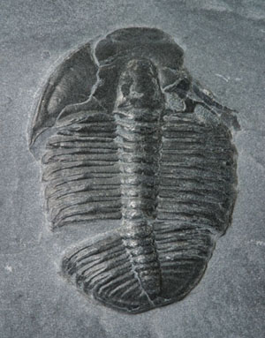
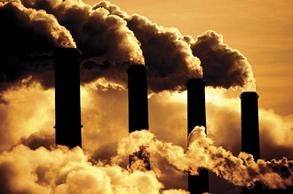
The carbon cycle
Four main types of processes in carbon cycle:
1.Biological processes (ex. photosynthesis, respiration, decomposition) that take up and release carbon and oxygen.
2.Geochemical processes (ex erosion and volcanic activity) that release carbon dioxide (CO₂) into the atmosphere
3.Biogeochemical processes (ex. decomposition of dead organisms and their conversion under pressure into fossil fuels) store carbon underground
4.Human activities (mining, cutting and burning forests, burning fossil fuels) release carbon dioxide into the atmosphere

Slide 11
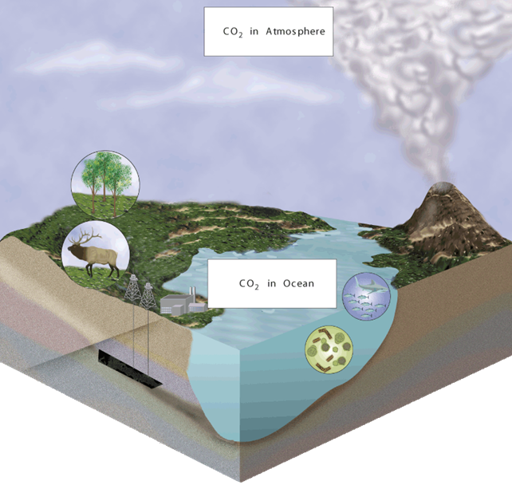
The carbon cycle
CO₂ in Atmosphere
Photosynthesis
Volcanic activity
feeding
Respiration
Human activity
Erosion
Decomposition
CO₂ in Ocean
Respiration
Uplift
Deposition
Photosynthesis
feeding
Fossil fuel
Deposition
Carbonate Rocks
Notes:
Carbon is found in several large reservoirs in the biosphere. In the atmosphere, it is found as carbon dioxide gas; in the oceans as dissolved carbon dioxide; on land in organisms, rocks, and soil; and underground as coal, petroleum, and calcium carbonate rock.

Slide 12
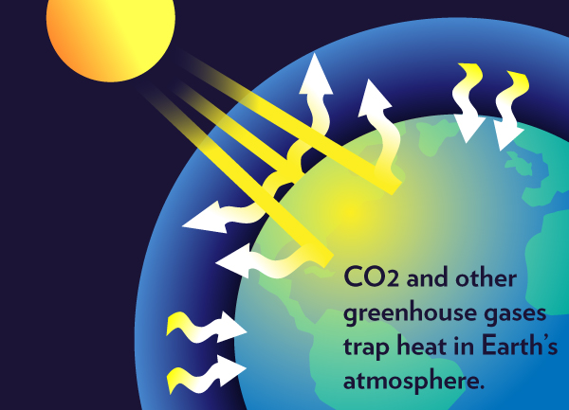
The carbon cycle
Carbon dioxide is a greenhouse gas: it traps heat that radiates from Earth and keeps it from being dissipated in space
As the amount of carbon dioxide in the atmosphere increases, the atmosphere is able to trap more and more heat → global warming

Slide 13
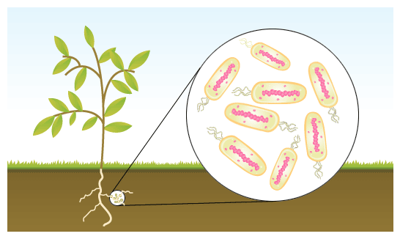
The nitrogen cycle
All organisms require nitrogen to make proteins
Nitrogen gas is the most abundant form of nitrogen on Earth, but only certain types of bacteria can use this form directly; they convert nitrogen gas into ammonia
The process of converting nitrogen gas into ammonia is called nitrogen fixation
Nitrogen-fixing bacteria live inthe soil and on the roots of certain plants; they convert nitrogen gas to ammonia

Slide 14
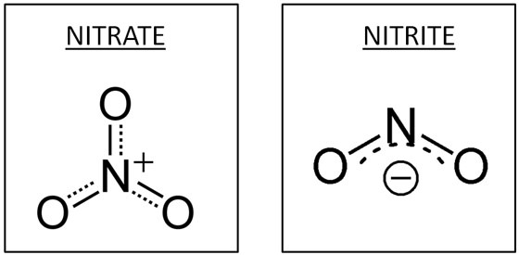
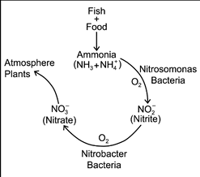
The nitrogen cycle
Other soil bacteria convert the ammonia into nitrates and nitrites
Producers use nitrates and nitrites to make proteins
Consumers eat producers and re-use the nitrogen to make their own proteins
When organisms die, decomposers return nitrogen to the soil as ammonia
Ammonia is converted to nitrates and nitrites and then
taken up by producers, or
converted back to nitrogen gas by other soil bacteria – process called denitrification – and released back to atmosphere

Slide 15
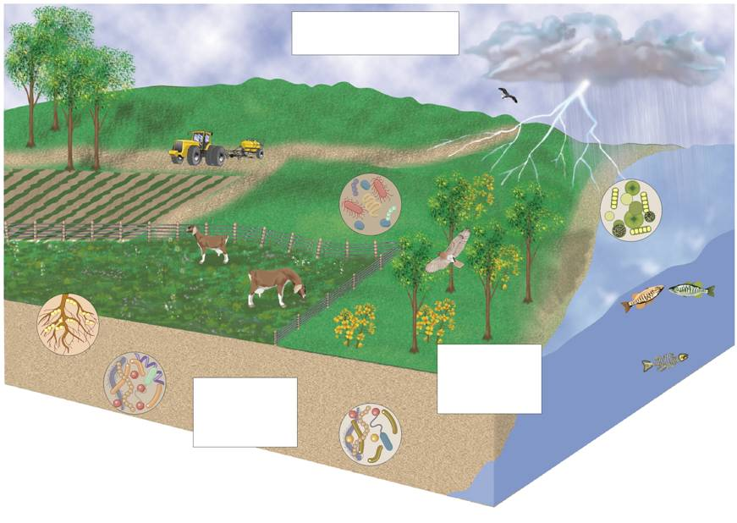
The nitrogen cycle
N₂ in Atmosphere
Synthetic fertilizer manufacturer
Atmospheric nitrogen fixation
Decomposition
Uptake by producers
Reuse by consumers
Uptake by producers
Reuse by consumers
Decomposition excretion
Decomposition excretion
Bacterial nitrogen fixation
NO₃ and NO₂
NH₃
(nitrates and nitrites)
Notes:
The atmosphere is the main reservoir of nitrogen in the biosphere. Nitrogen also cycles through the soil and through the tissues of living organisms.

Slide 16
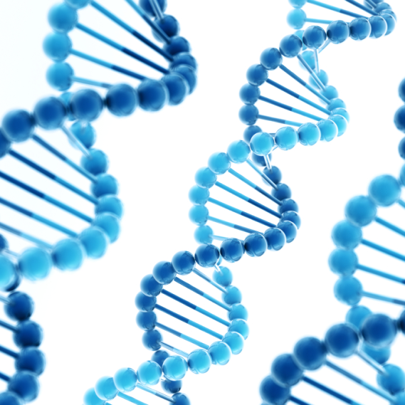
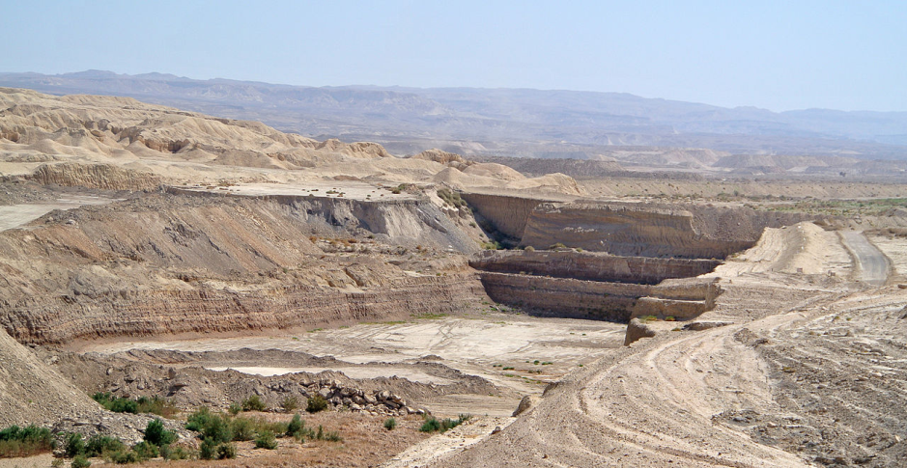
The phosphorous cycle
All organisms require phosphorous because it is a component of DNA and RNA
Most phosphorus exists as inorganic phosphate in sediments
released into soil and water as sediments wear down
bound into organic compounds by plants and marine organisms
Phosphorite mine near Oron, Negev, Israel.

Slide 17
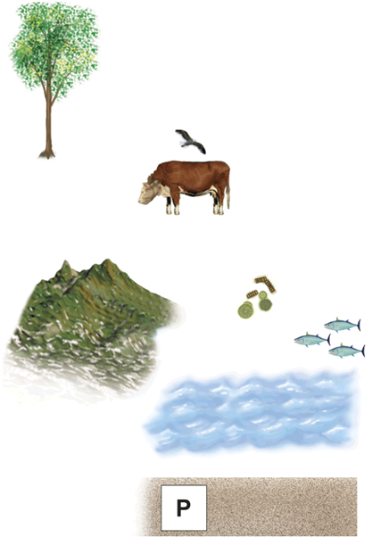
The phosphorous cycle
Organic phosphate moves through the food web and to the rest of the ecosystem.
Organisms
Land
Ocean
Sediments
Notes:
Phosphorus in the biosphere cycles among the land, ocean sediments, and living organisms.

Slide 18
Nutrient limitation
Primary productivity: the rate at which producers in an ecosystem create organic matter
Affect by the amount of nutrients available
If a nutrient is in a short supply, it will limit an organism’s growth
When an ecosystem is limited by a single nutrient that is scarce or cycles very slowly, this substance is called a limiting nutrient.

Slide 19
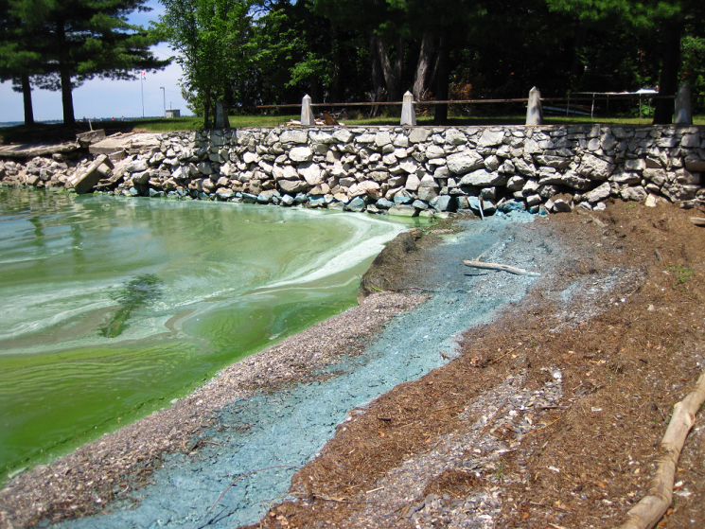
Example of Nutrient limitation
When an aquatic ecosystem receives a large input of a limiting nutrient—such as runoff from heavily fertilized fields:
The result is often an immediate increase in the amount of algae and other producers.
This result is called an algal bloom (not enough consumers to slow the algal growth).
Algal blooms can disrupt the equilibrium of an ecosystem.
Cyanobacteria blooms at the Missisquoi Bay, Quebec

