Slide 1
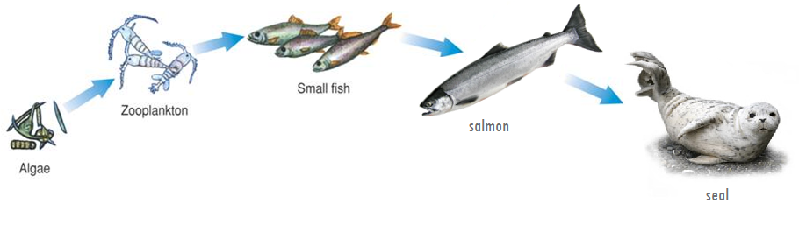
3-2 Energy flow
Notes:
Photo Credit: ©Bruce Coleman, LTD/Natural Selection

Slide 2
3.2 Energy flow (p67-73)
  The flow of energy through an ecosystem is one of the most important factors that determines the system’s capacity to sustain life.
  In the nature, organisms are
    Producers
    or
    Consumers

Slide 3

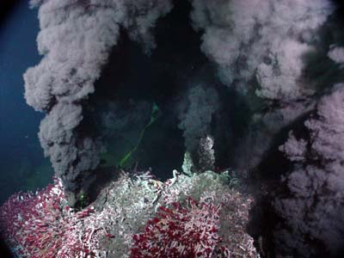
Producers
  Producers, also called autotrophs (auto = oneself, troph = feed), convert another form of energy (ex. sunlight) into chemical energy
    Photoautotrophs use the sun – most common
    Chemoautotrophs (certain bacteria) use chemicals – ex. bacteria at deep-sea hydrothermal vents

Slide 4
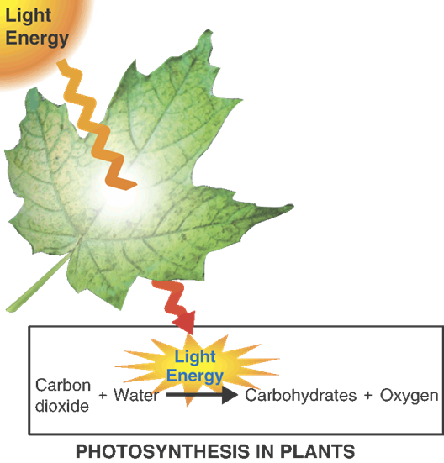
Producers
  Photosynthesis
    Producers that rely on the sun for energy use a chemical process called photosynthesis:
      requires sunlight, carbon dioxide and water
      results in carbohydrates (sugars – energy for the plant) and oxygen
      Photosynthesis adds oxygen to the Earth’s atmosphere and removes carbon dioxide

Slide 5
Producers
  Life Without Light
    Some autotrophs (producers) can produce food in the absence of light.
    When organisms use chemical energy to produce carbohydrates, the process is called chemosynthesis.

Slide 6
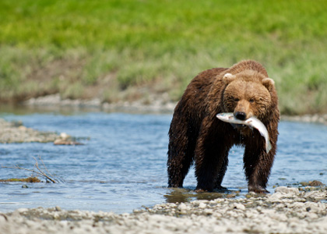
Consumers
    Consumers (or heterotrophs (hetero = other, troph = feed) are organisms that rely on other organisms for their energy and food supply are called consumers.
    Includes animals, bacteria and fungi

Slide 7
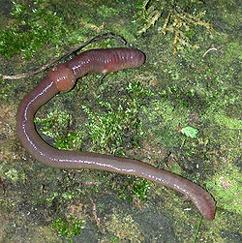
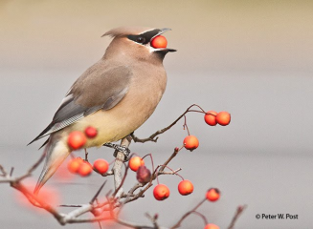
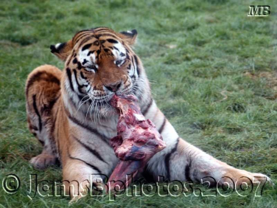
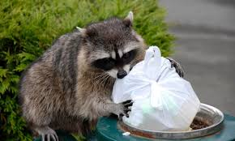
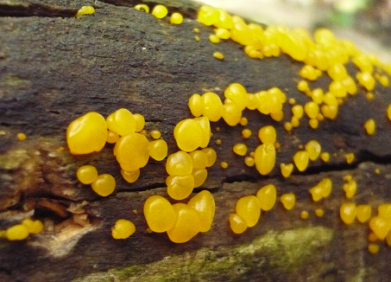
Consumers
There are many different types of heterotrophs.
    Herbivores or primary consumers eat the producers (plants, algae, etc).
    Carnivores eat other animals. (ex. bear eats salmon)
    Omnivores eat both plants and other animals.
    Detritivores feed on plant and animal remains and other dead matter. (ex. pieces of salmon carcass give nutrients to a worm)
    Decomposers, like bacteria and fungi, break down dead organic matter. (ex. salmon carcass dropped in forest give nutrient to bacteria)

Slide 8
Feeding relationships
Food Chains
  A food chain is a series of steps in which organisms transfer energy by eating and being eaten.

Slide 9
Feeding relationships
Trophic Levels
    Each step in a food chain or food web is called a trophic level.
    Producers make up the first trophic level.
    Consumers make up the second, third, or higher trophic levels.
    Each consumer depends on the trophic level below it for energy.
Trophic
levels:
Producer Primary Secondary Tertiary Quaternary
consumer consumer consumer consumer

Slide 10
Feeding relationships
Food Webs
    Ecologists make food webs.
    A food web links the food chains in an ecosystem together.
    It shows multiple connections
    Represent the complex patterns of energy flow that occur in natural ecosystems

Slide 11
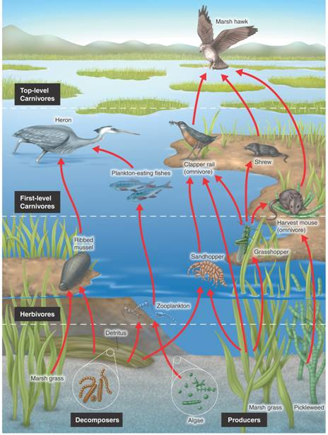
Feeding relationships
Creating Food Webs
ex: Food web in a salt marsh
Arrange producers at the base of the food web
Add subsequent trophic levels above producers
Add arrows to indicate the direction of energy flow and the importance of each interaction
A complete food web includes detritivores and decomposers!

Slide 12
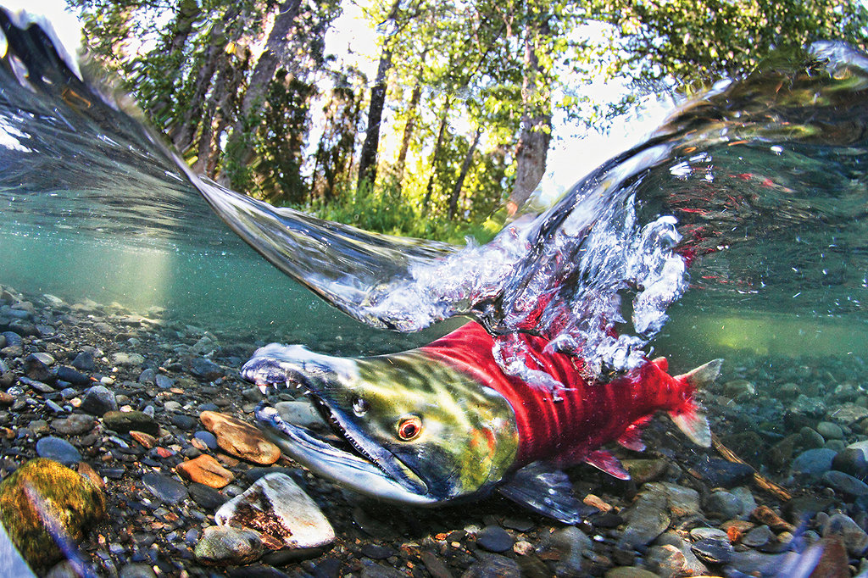
Feeding relationships
Food Webs Exercise
    → Create a food web of the Adams River when the sockeye salmons are there.
    Indicate the trophic levels

Slide 13
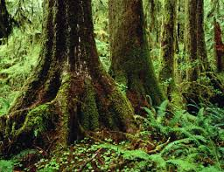
Feeding relationships
Food Webs Exercise
    → Create a food web of the temperate rainforest
    Indicate the trophic levels

Slide 14
Ecological pyramids
Ecological pyramids are diagram that shows relative amounts of energy or matter contained within each trophic level in a food chain or food web
    Can be used to show:
      Energy transferred at each trophic level
      Biomass at each trophic level
      Numbers of organisms at each trophic level

Slide 15
Ecological Pyramids
  Energy Pyramid
  Shows the relative amount of energy available at each trophic level.
  Only about 10% of energy stored in one trophic level is passed on to the next level
0.1% Third-level
consumers
1% Second-level consumers
10% First-level consumers
100% Producers
Notes:
Ecological pyramids show the decreasing amounts of energy, living tissue, or number of organisms at successive feeding levels. The pyramid is divided into sections that represent each trophic level. Because each trophic level harvests only about one tenth of the energy from the level below, it can support only about one tenth the amount of living tissue.

Slide 16
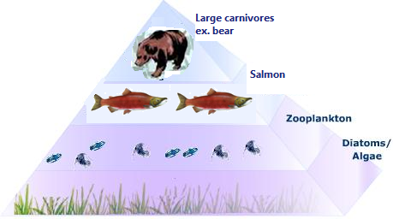
Ecological Pyramids
Biomass Pyramid
Represents the amount of living organic matter at each trophic level. Typically, the greatest biomass is at the base of the pyramid.
50 g of bear tissue
500 g of salmon tissue
500 g of zooplankton
5000 g of algae
Notes:
Ecological pyramids show the decreasing amounts of energy, living tissue, or number of organisms at successive feeding levels. The pyramid is divided into sections that represent each trophic level. Because each trophic level harvests only about one tenth of the energy from the level below, it can support only about one tenth the amount of living tissue.

Slide 17
Ecological Pyramids
Biomass Pyramid
Biomass is the total amount of living tissue
    Usually expressed as grams of organic matter per unit area
A biomass pyramid shows the amount of living tissue within each trophic level
  represent amount of potential food available for each trophic level in an ecosystem
50 g of bear tissue
500 g of salmon tissue
500 g of zooplankton
5000 g of algae
Notes:
Ecological pyramids show the decreasing amounts of energy, living tissue, or number of organisms at successive feeding levels. The pyramid is divided into sections that represent each trophic level. Because each trophic level harvests only about one tenth of the energy from the level below, it can support only about one tenth the amount of living tissue.

Slide 18
Ecological Pyramids
Pyramid of Numbers
Shows the relative number of individual organisms at each trophic level.
Notes:
Ecological pyramids show the decreasing amounts of energy, living tissue, or number of organisms at successive feeding levels. The pyramid is divided into sections that represent each trophic level. Because each trophic level harvests only about one tenth of the energy from the level below, it can support only about one tenth the amount of living tissue.

Slide 19
Ecological Pyramids
For some ecosystems, the shape of the pyramid of numbers is the same as that of energy and biomass pyramids
In some ecosystems, there are few, large producers – so their pyramid of numbers would look different from the energy and biomass ones
– can you think of such an ecosystem?
Notes:
Ecological pyramids show the decreasing amounts of energy, living tissue, or number of organisms at successive feeding levels. The pyramid is divided into sections that represent each trophic level. Because each trophic level harvests only about one tenth of the energy from the level below, it can support only about one tenth the amount of living tissue.

Slide 20
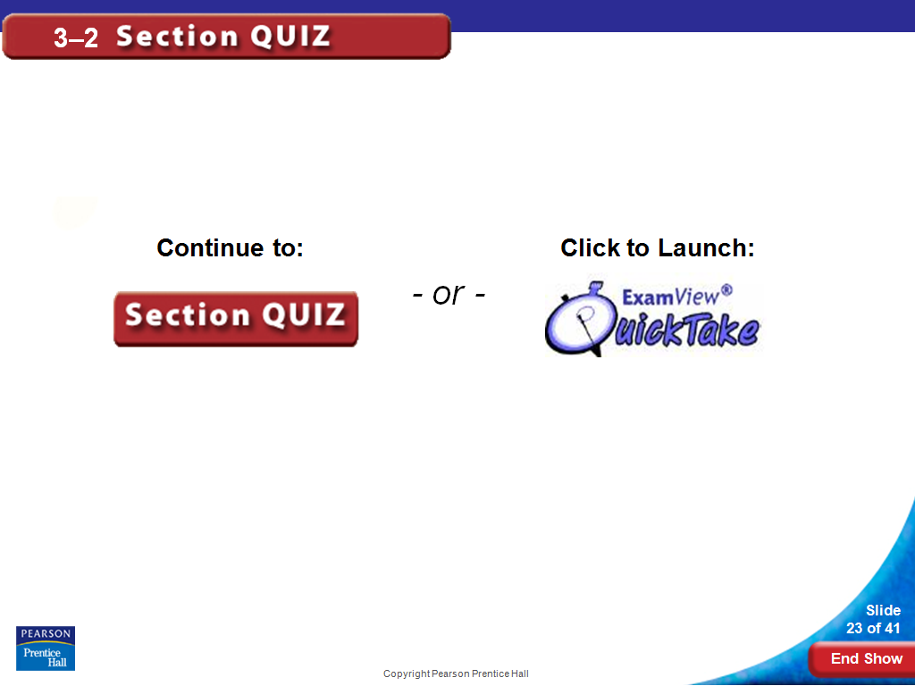

Slide 21
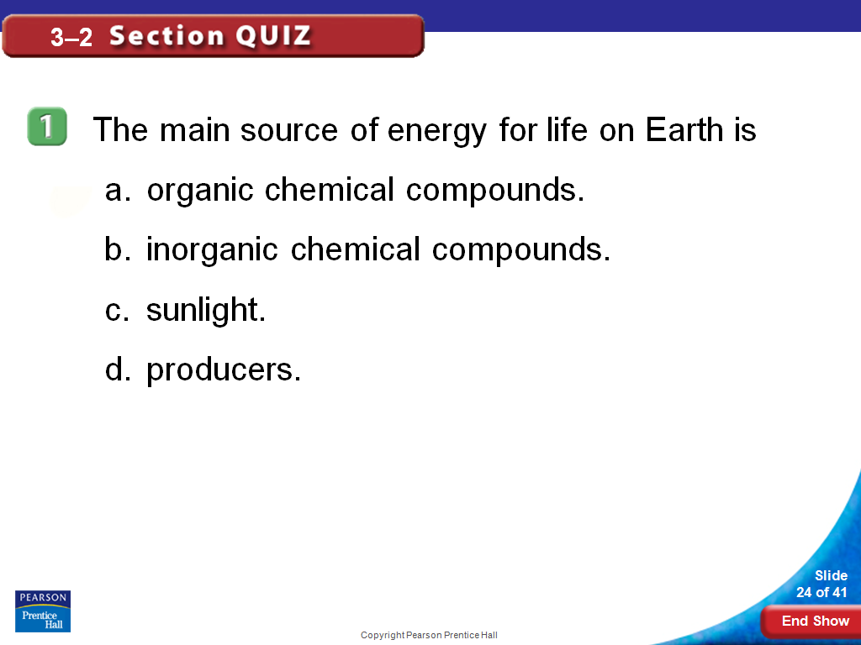

Slide 22
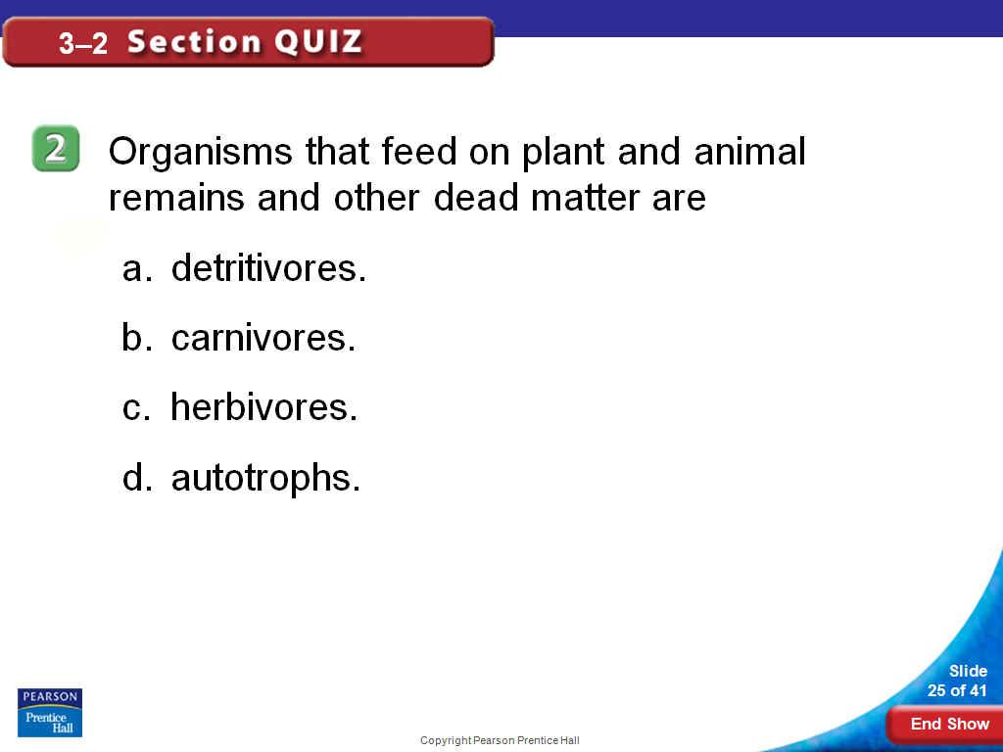

Slide 23
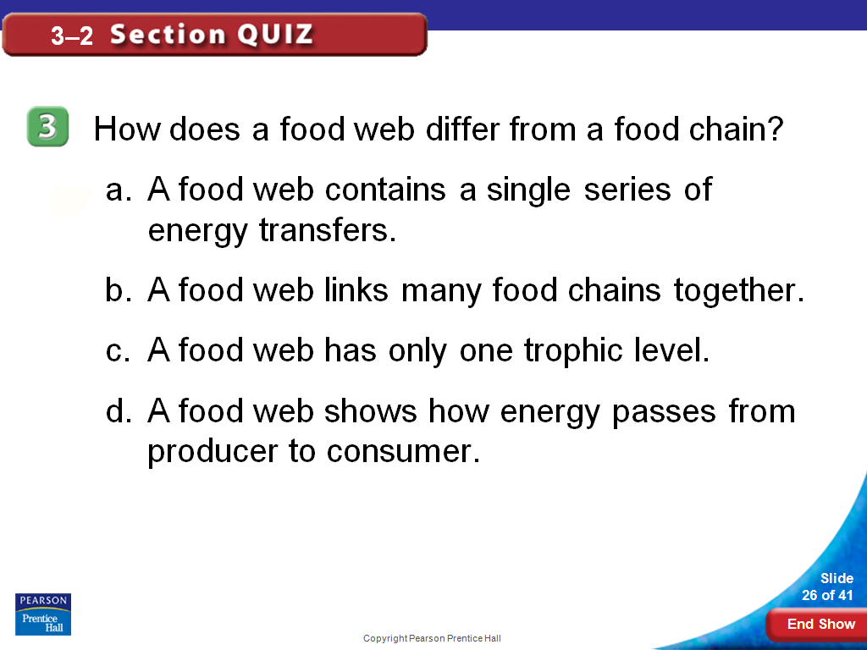

Slide 24
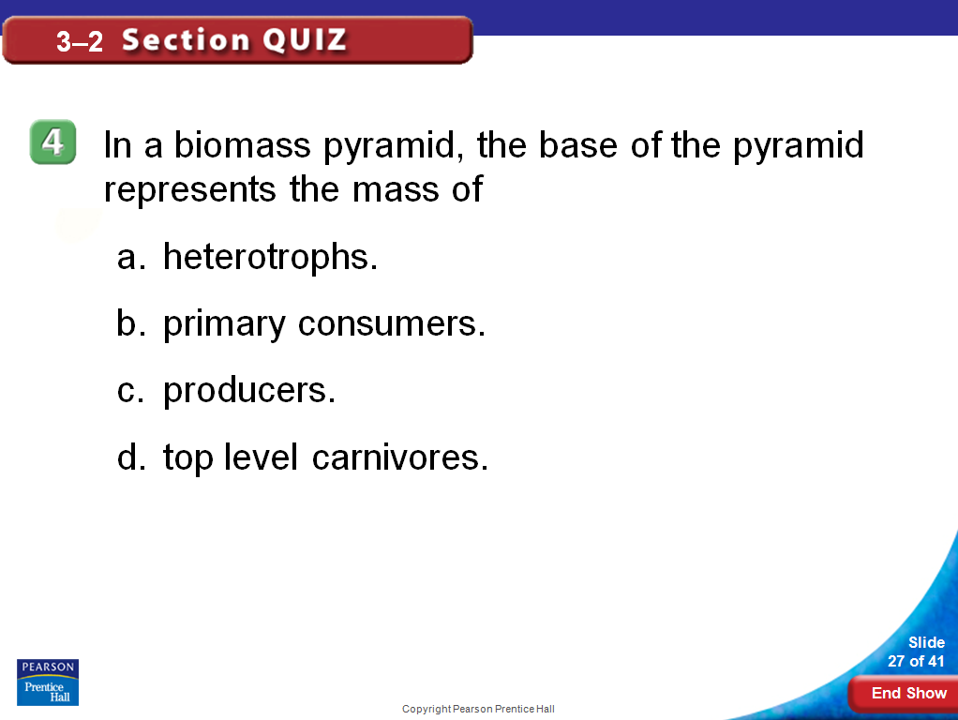

Slide 25
