Slide 1
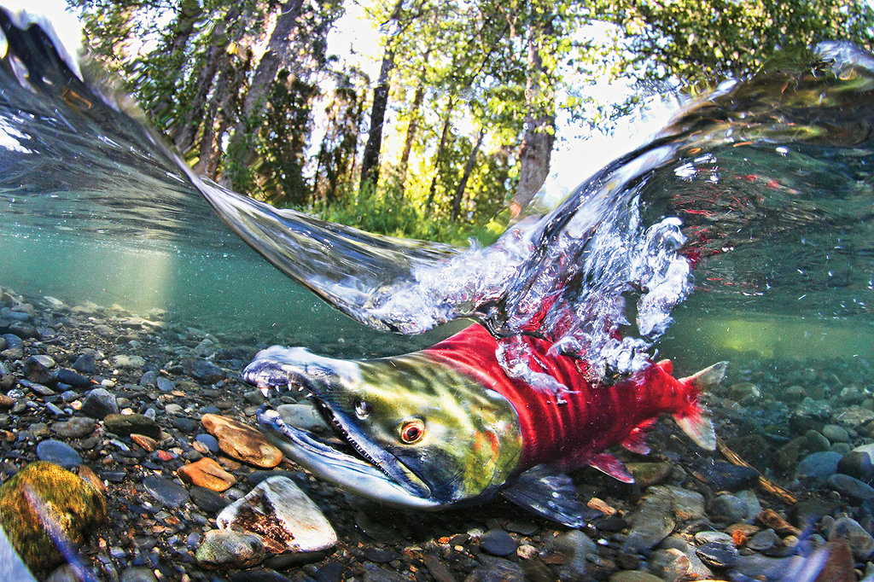
Feeding relationships
Food Webs
→ Create a food web of the Adams River when the sockeye salmons are there.
Indicate the trophic levels

Slide 2
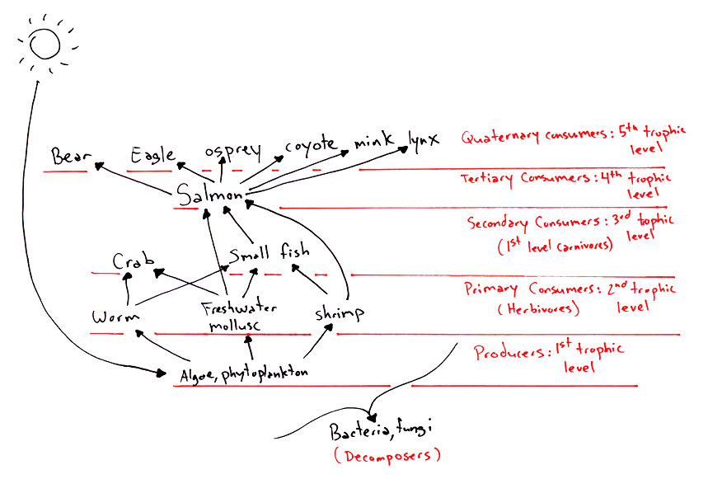
Feeding relationships
Adams River Food Webs

Slide 3
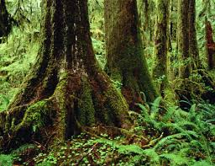
Feeding relationships
Food Webs
→ Create a food web of the temperate rainforest
Indicate the trophic levels

Slide 4
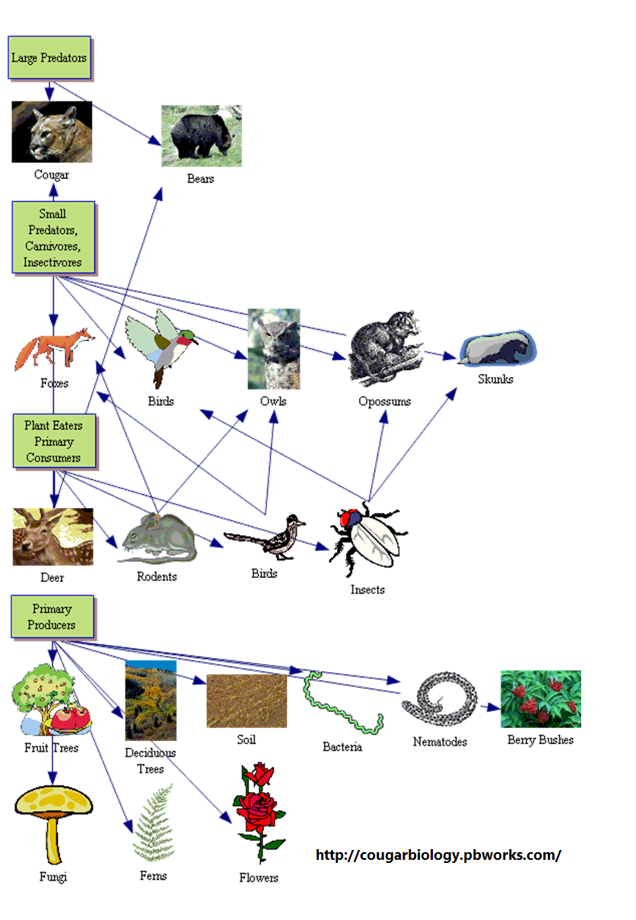
Feeding relationships
Temperate rainforest Food Webs

