Slide 1
3-1 What Is Ecology?
Notes:
Photo Credit: ©Bruce Coleman, LTD/Natural Selection

Slide 2
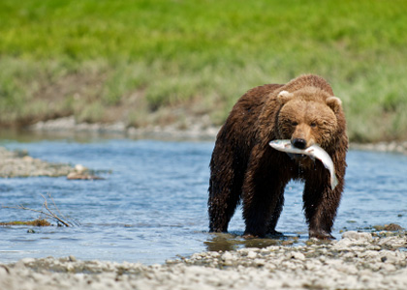
Ecology concepts 3.1 What is ecology? (p63-64)
Interactions and Interdependence
Ecology is the scientific study of interactions among organisms and between organisms and their environment, or surroundings.
Interactions within ecosystems produce a web of interdependence between organisms and the environment in which they live.

Slide 3
Ecology concepts 3.1 What is ecology? (p63-64)
To understand relationships within the biosphere, ecologists ask questions about events and organisms that range in complexity from a single individual to the entire biosphere.
The levels of organization that ecologists study include: individuals (species), populations, communities, ecosystems, and biomes.

Slide 4
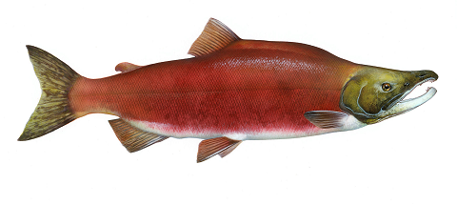
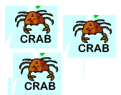
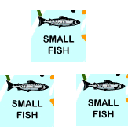
Ecology concepts – Levels of organization
A species is a group of organisms so similar to one another that they can breed and produce fertile offspring.
ex: Sockeye salmon (Oncorhynchus nerka)
Populations are groups of individuals that belong to the same species and live in the same area.
Communities are assemblages of different populations that live together in a defined area.

Slide 5
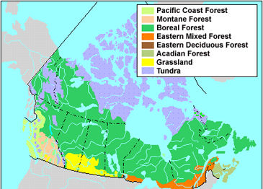
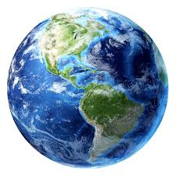
Ecology concepts – Levels of organization
An ecosystem is a collection of all the organisms that live in a particular place, together with their nonliving, or physical, environment.
ex. Adams River
A biome is a group of ecosystems that have the same climate and similar dominant communities.
ex. Pacific Coast Forest
The highest level of organization that ecologists study is the entire biosphere itself. It combines water, land and atmosphere.
Biomes of Canada

